Slide 1
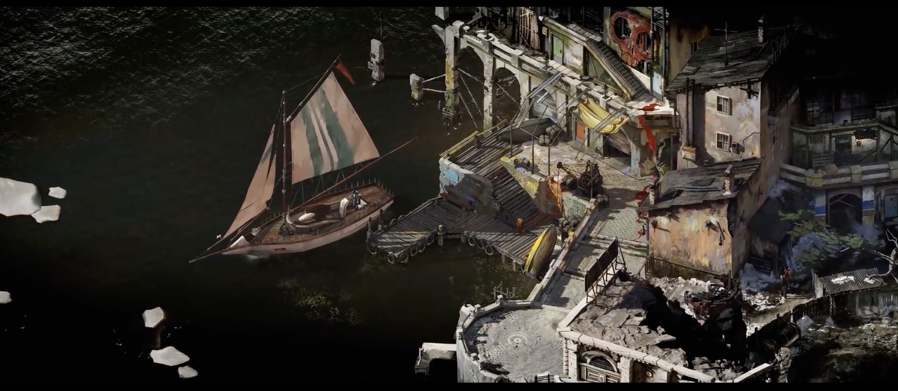
SORRY
Comma Centre

Slide 2


Slide 3
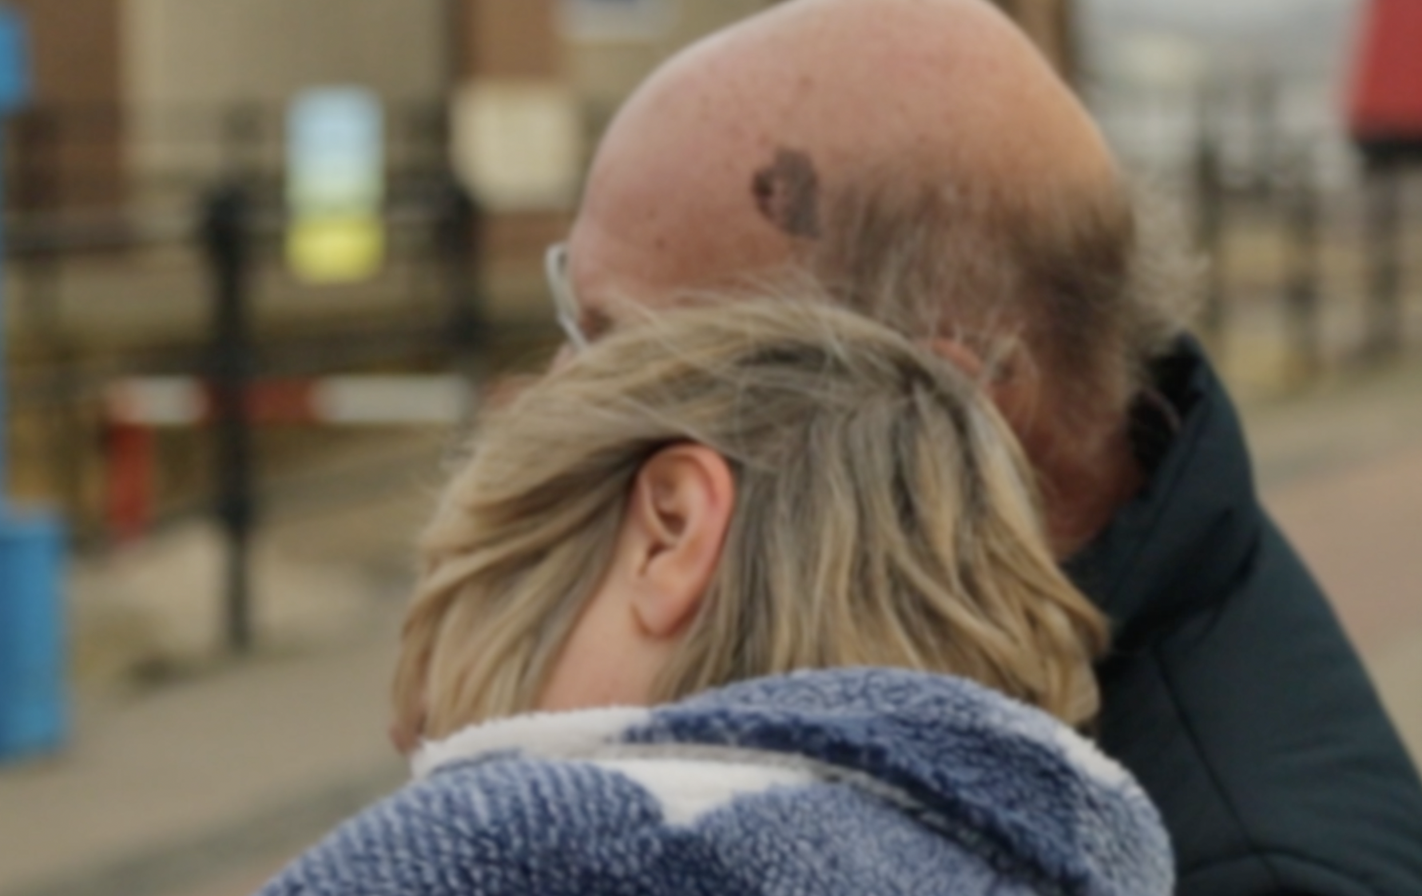

Slide 4
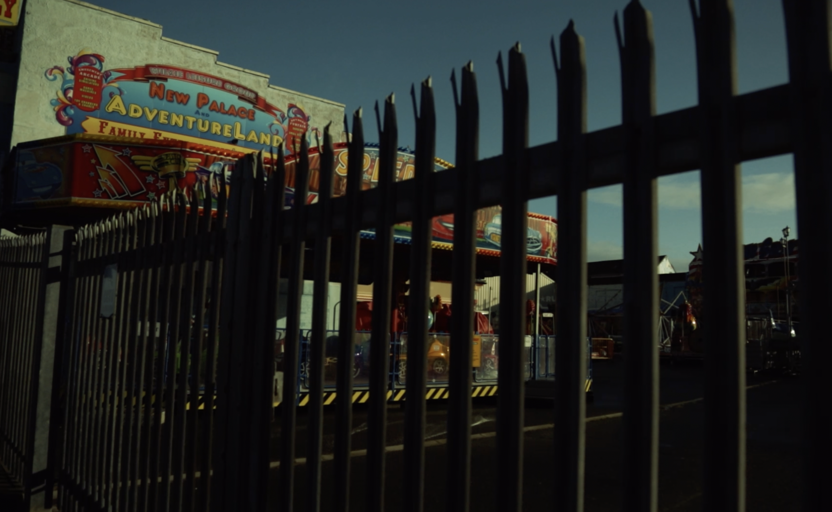

Slide 5
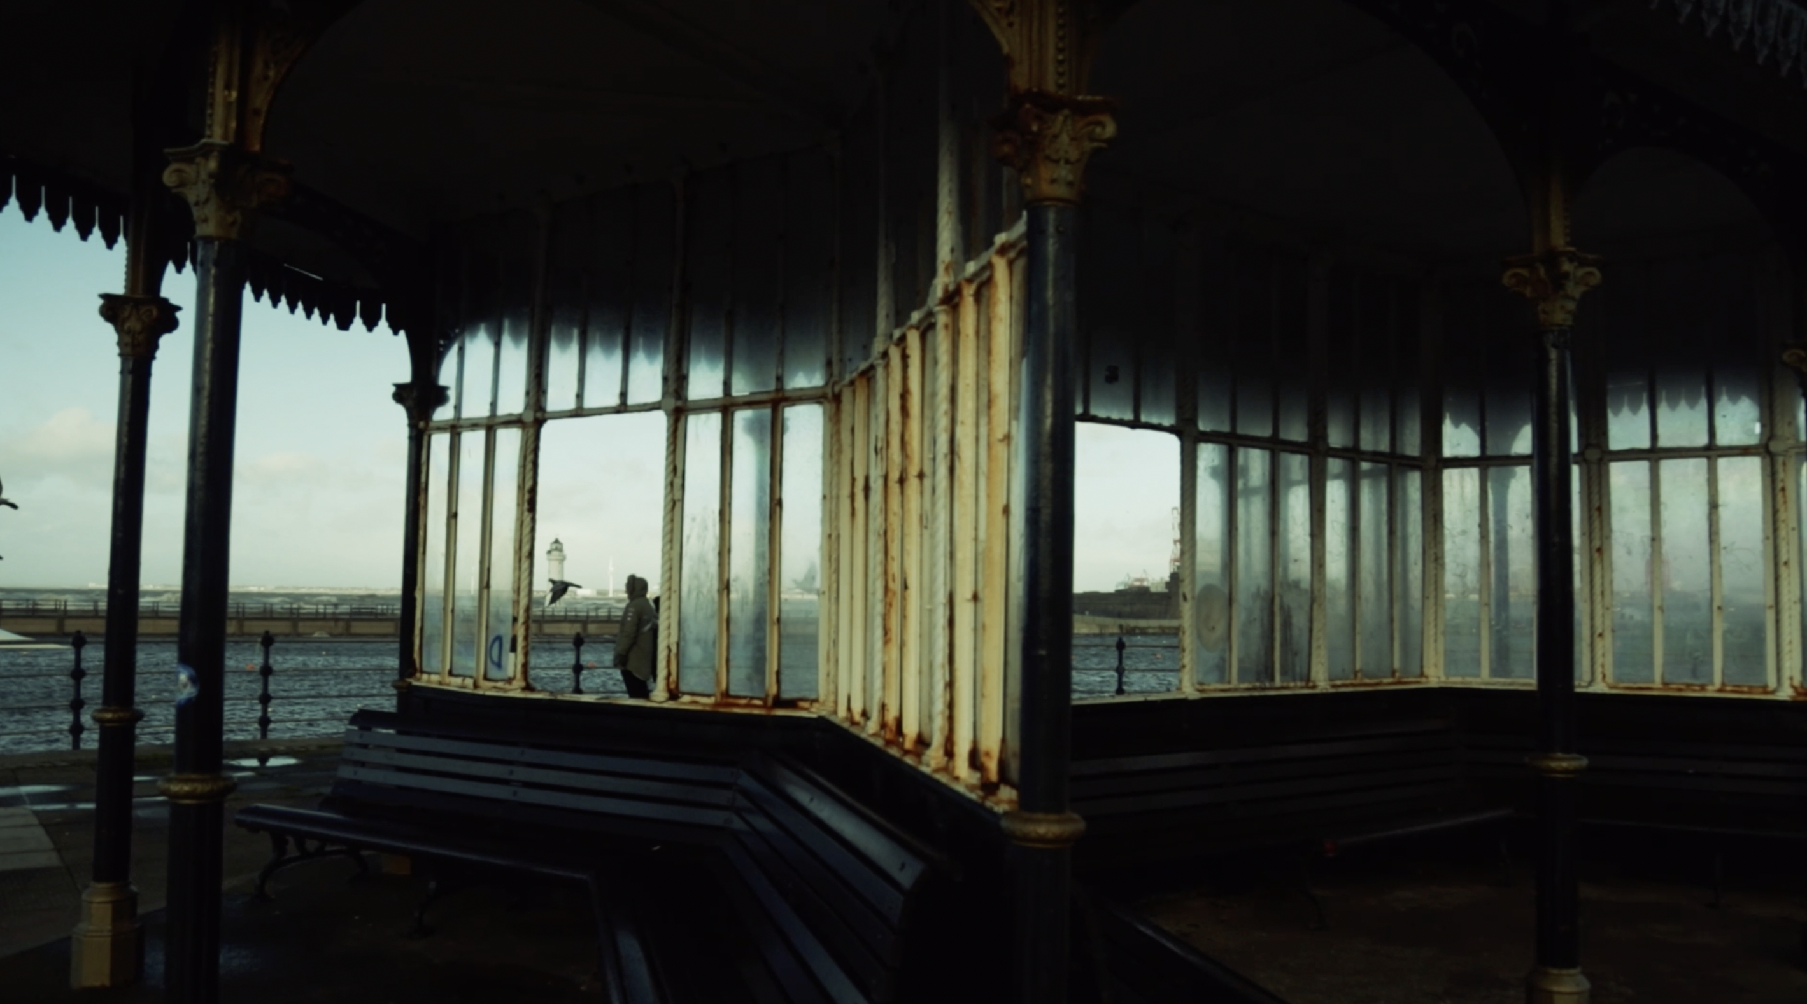

Slide 6
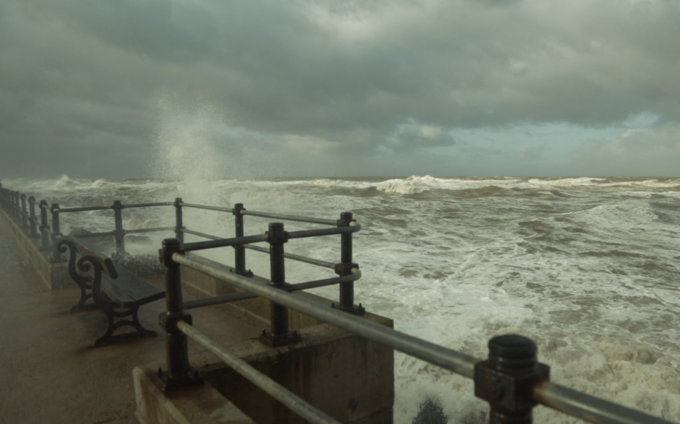

Slide 7


Slide 8
Tide
Anchor
Dissipation
Deposition

Slide 9
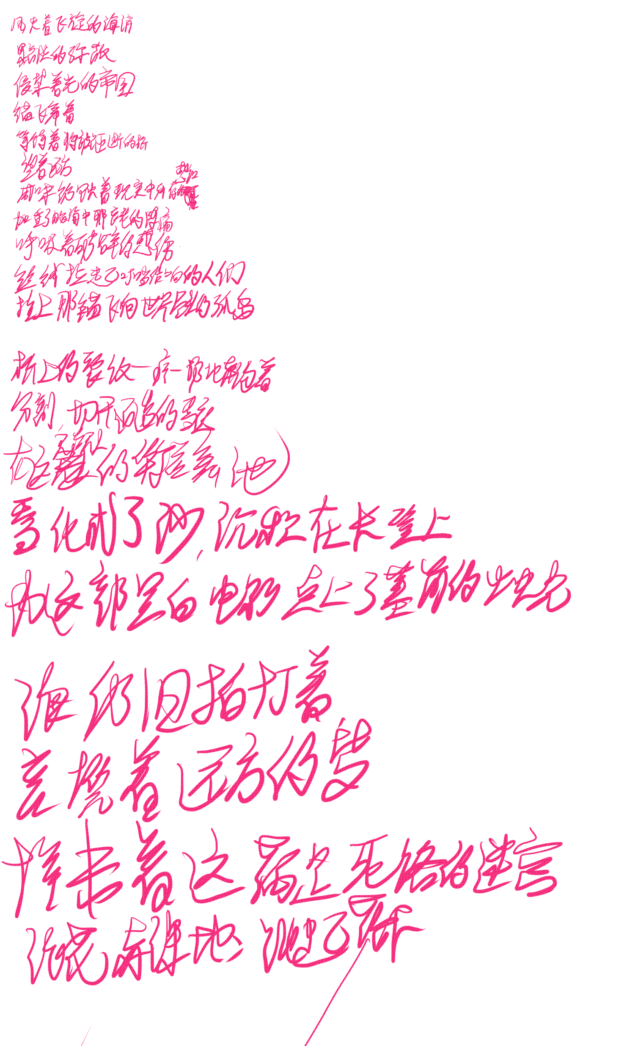
The wind is caught in the swirling sea drops
Dispersing dully
Infiltrating the empire of light
Anchors fluttering
Waiting for the smashed bridge
Looking into the distance
The salty taste rusts the remaining perception of reality
Aggravating the pain of aging in the mind
Breathing in a bit of broken sentiment
The threads pulling up the tinkling people
Tying anchors to fly to the island at the end of the world
The cracks on the bridge limp and run
Splitting and cutting through the snowy night
In this silent and unoccupied waltz
The snow turns to sand and is deposited on the benches
Lighting the graveside candle for this mono film
The sea still laps
Wrapped in a distant dream
Crashing in this maze of dead ends
Waves jumping nakedly
Bringing messages from the land of sunset
"Bright never expire"

Slide 10
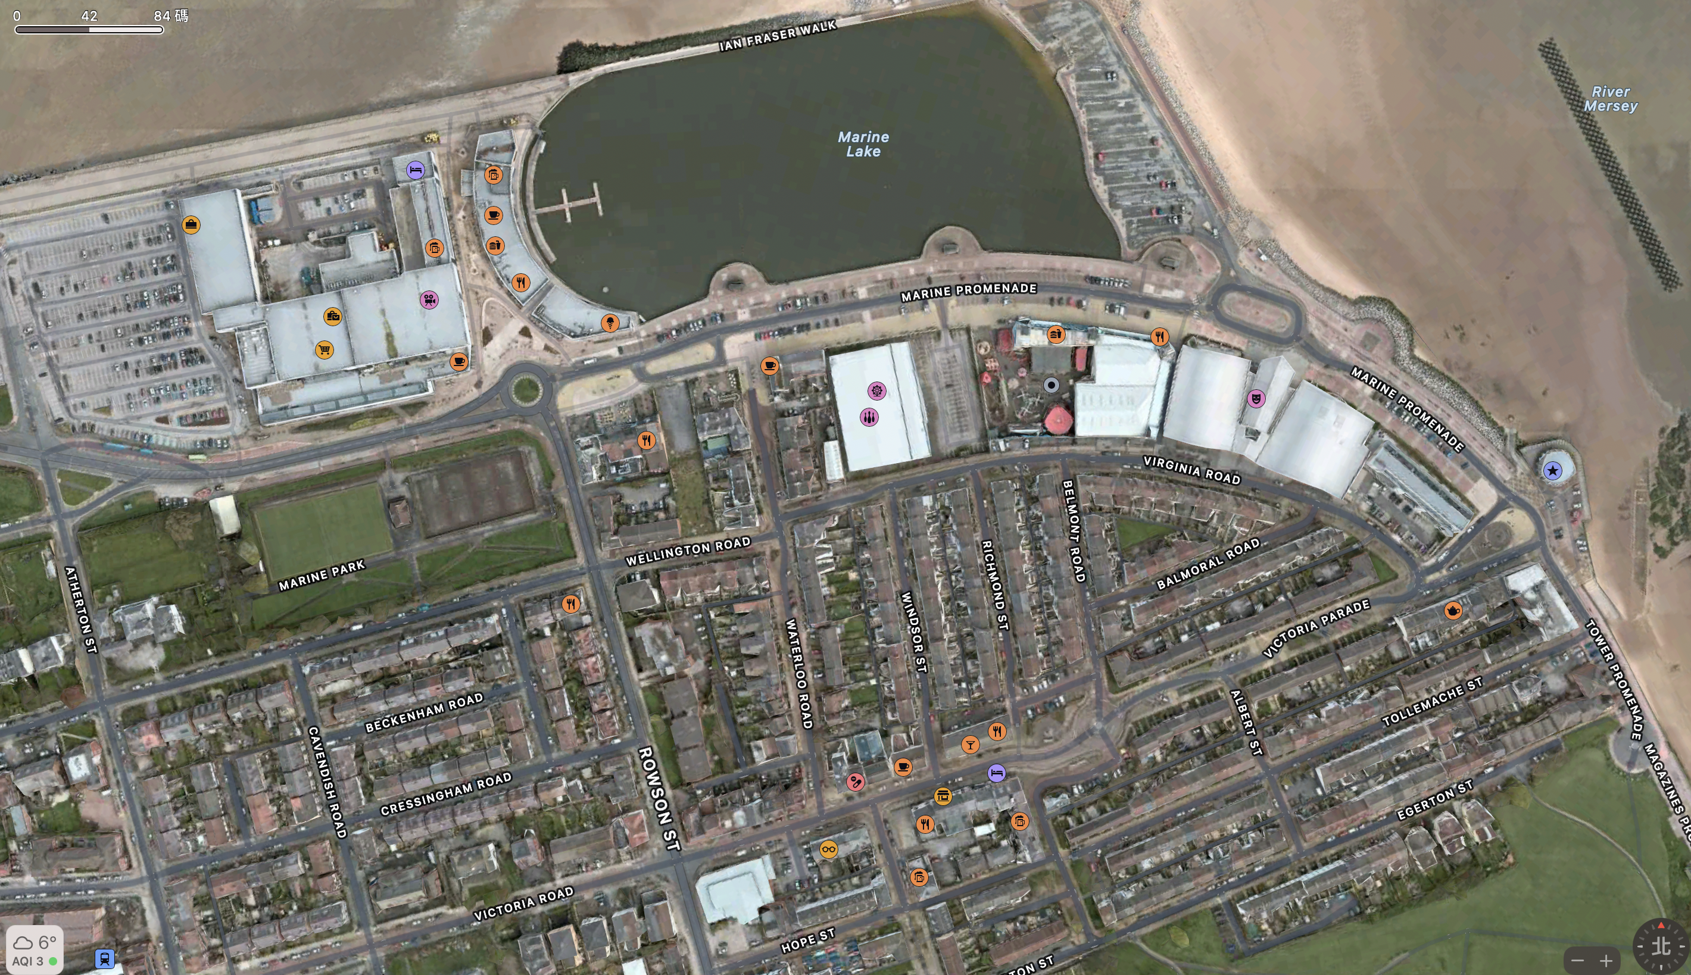

Slide 11
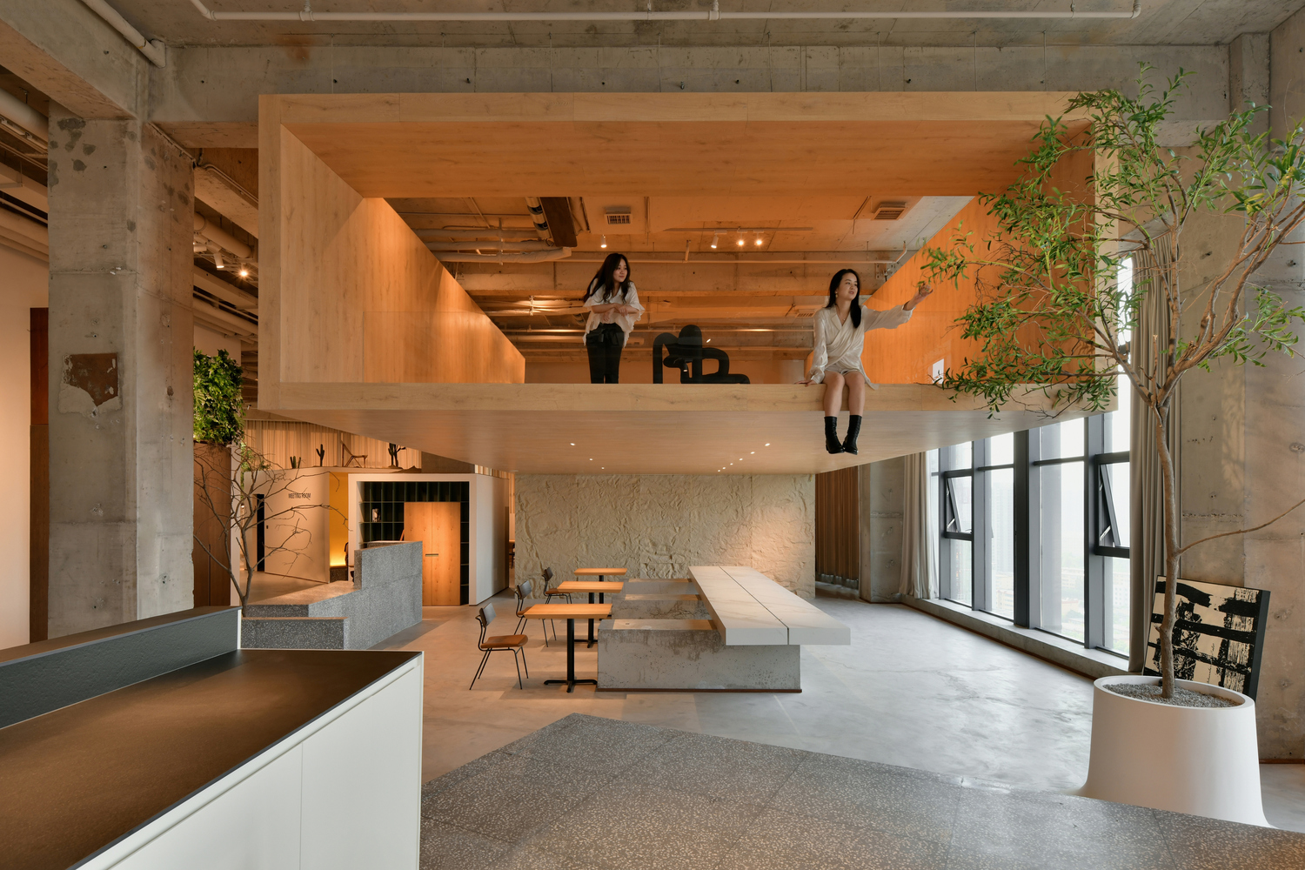
Precedent1
HANROW WOOD Taiyuan
HOOOLDESIGN STUDIO

Slide 12
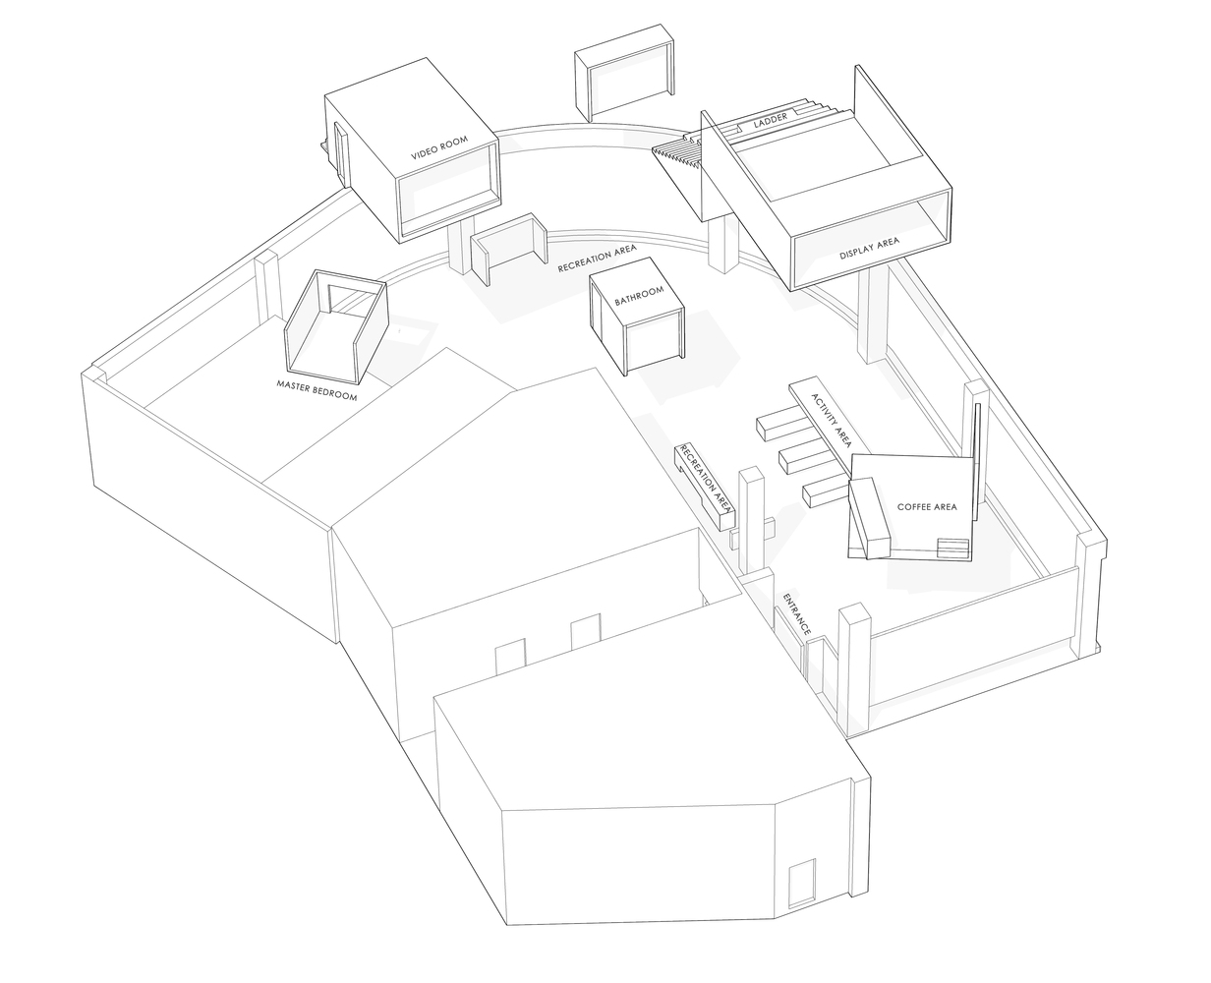

Slide 13
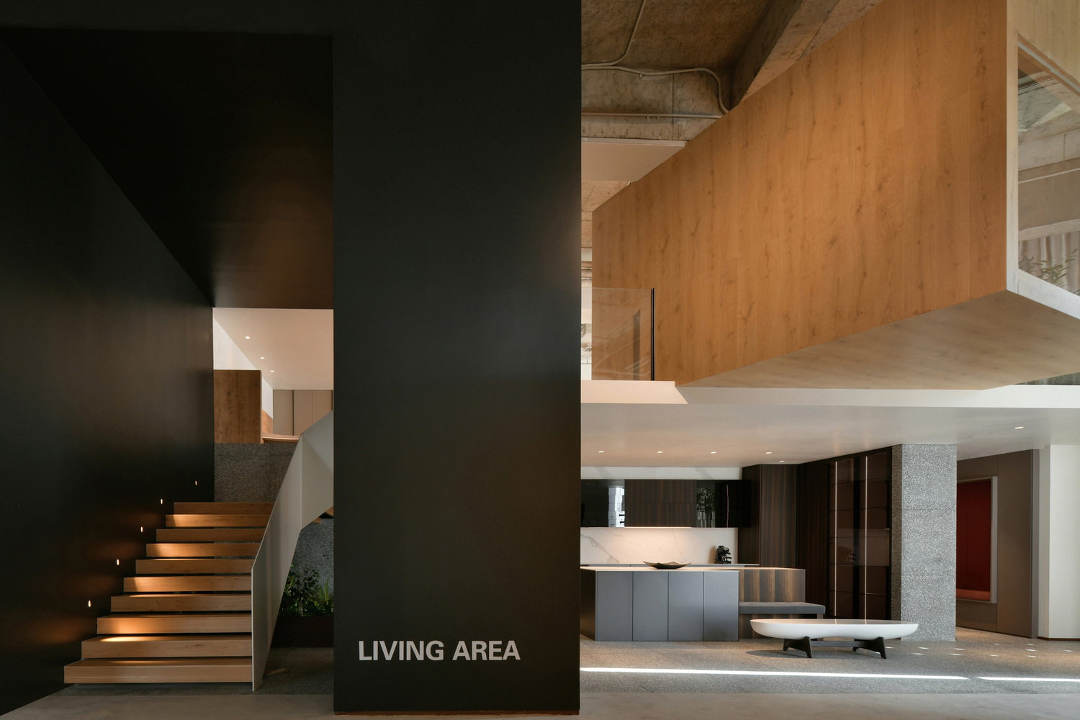

Slide 14
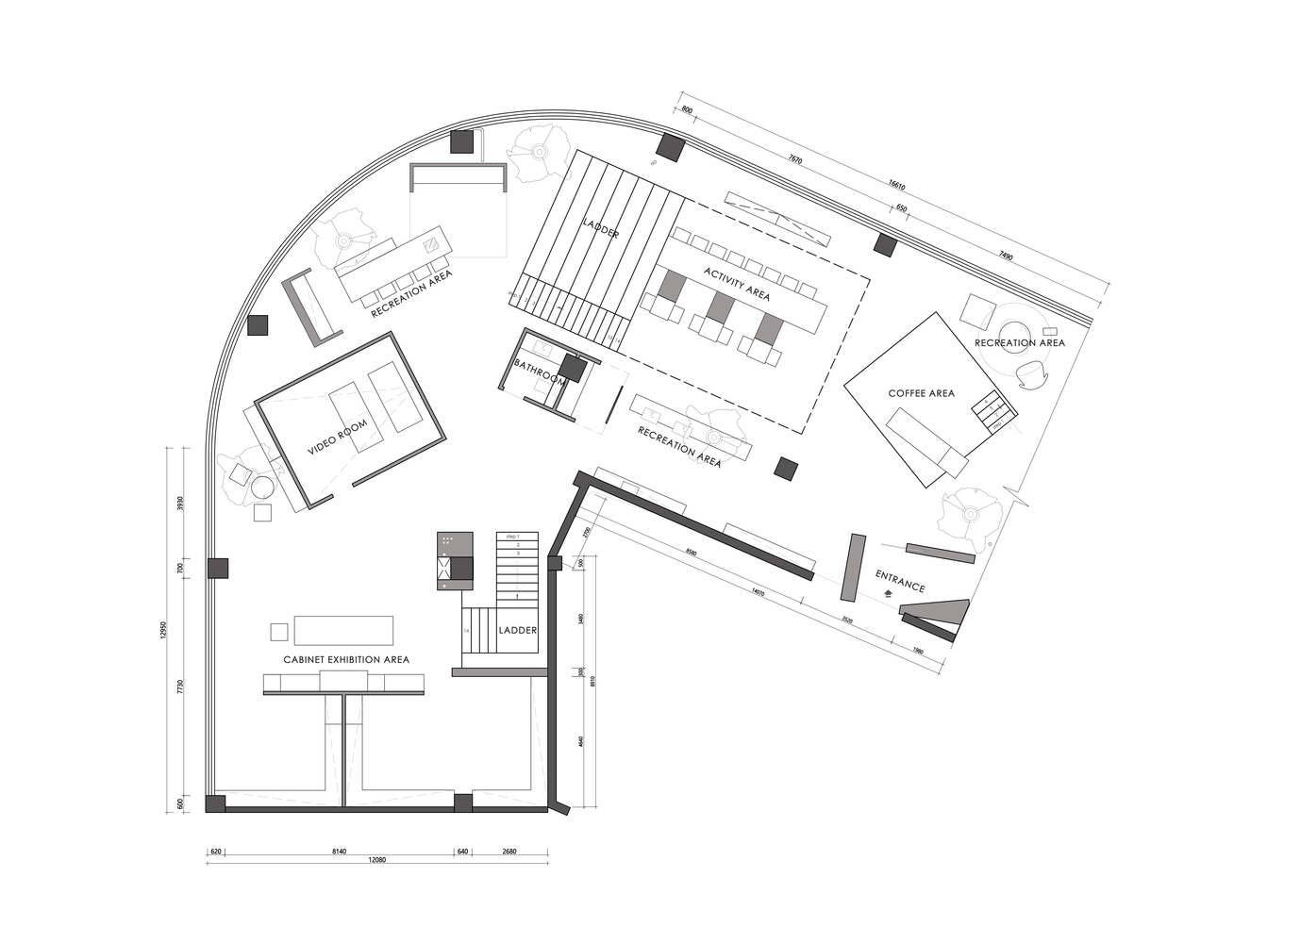

Slide 15
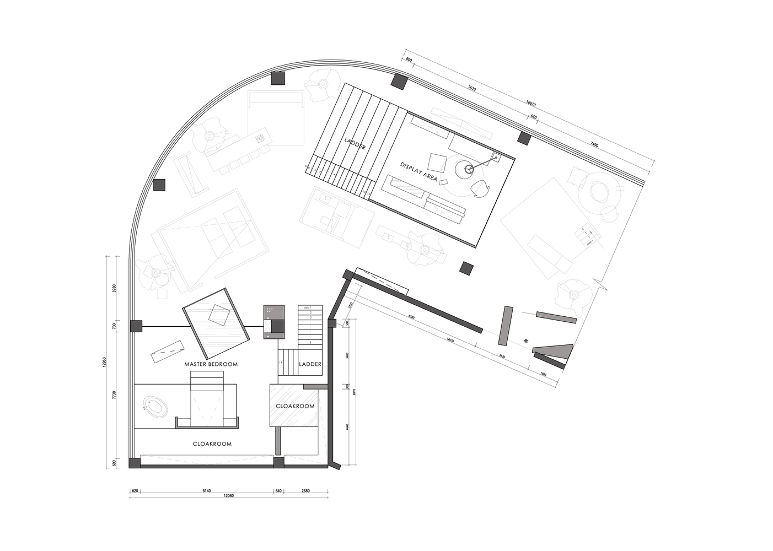

Slide 16
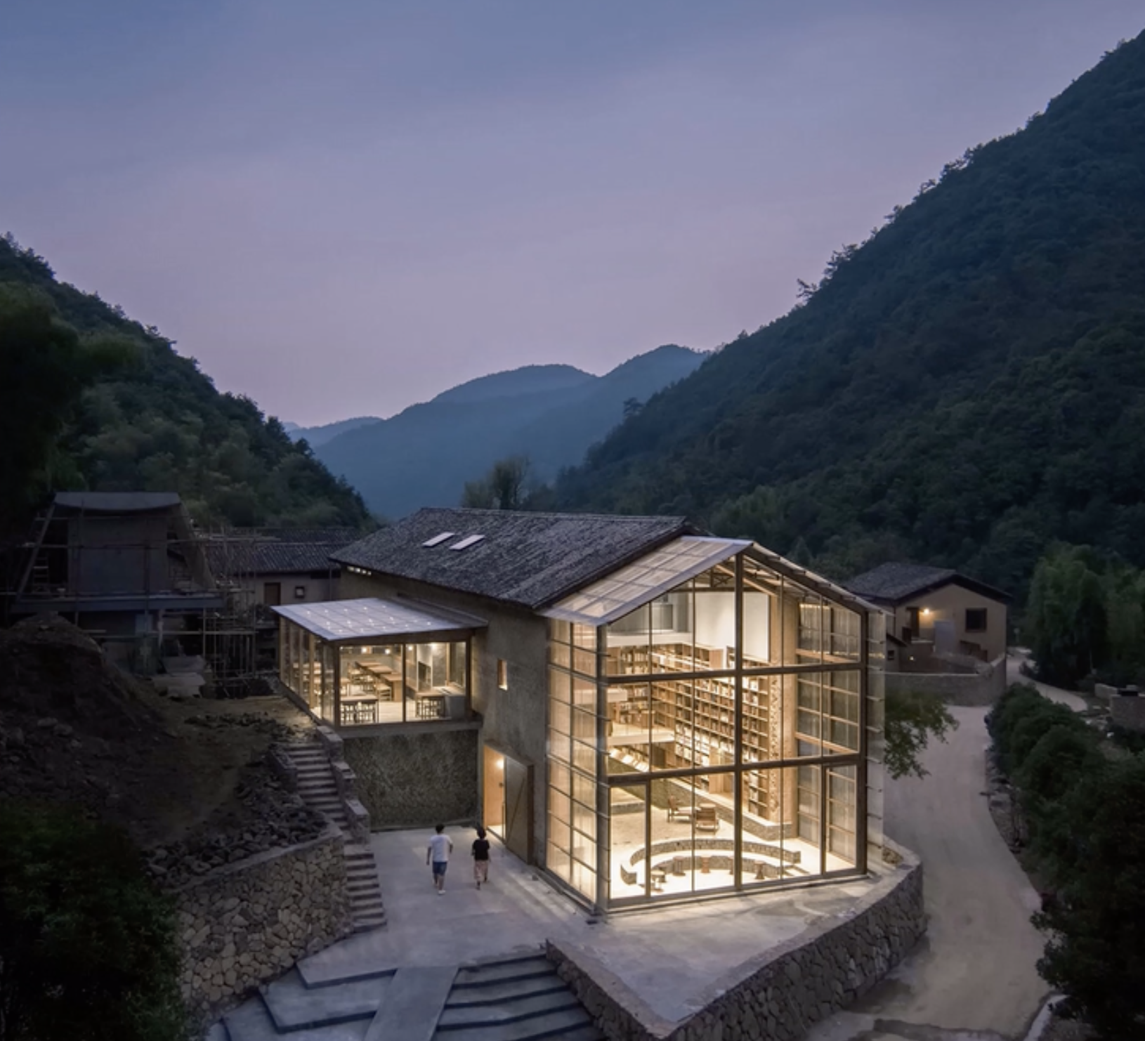
Precedent 2
CEMENTINE TREE HOTEL

Slide 17
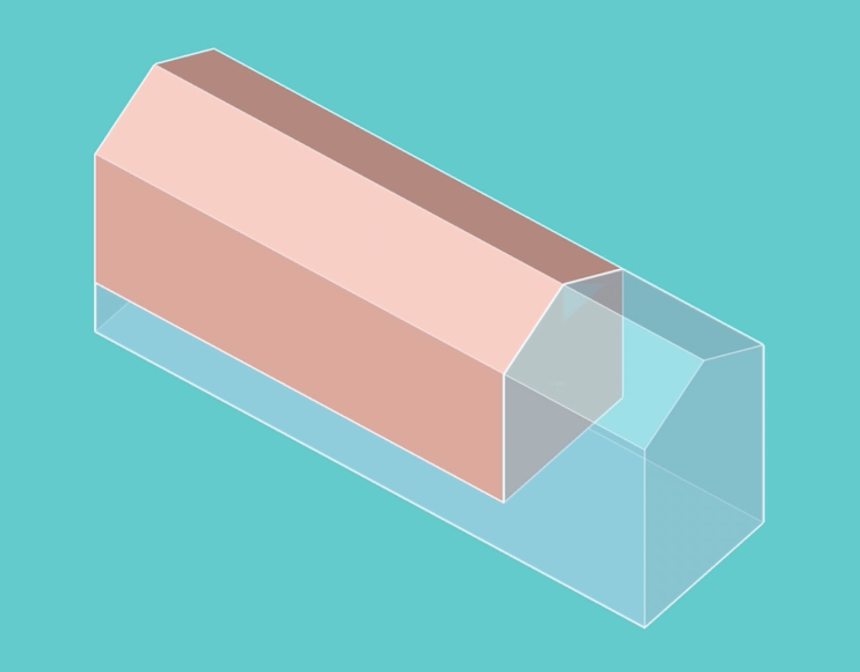

Slide 18
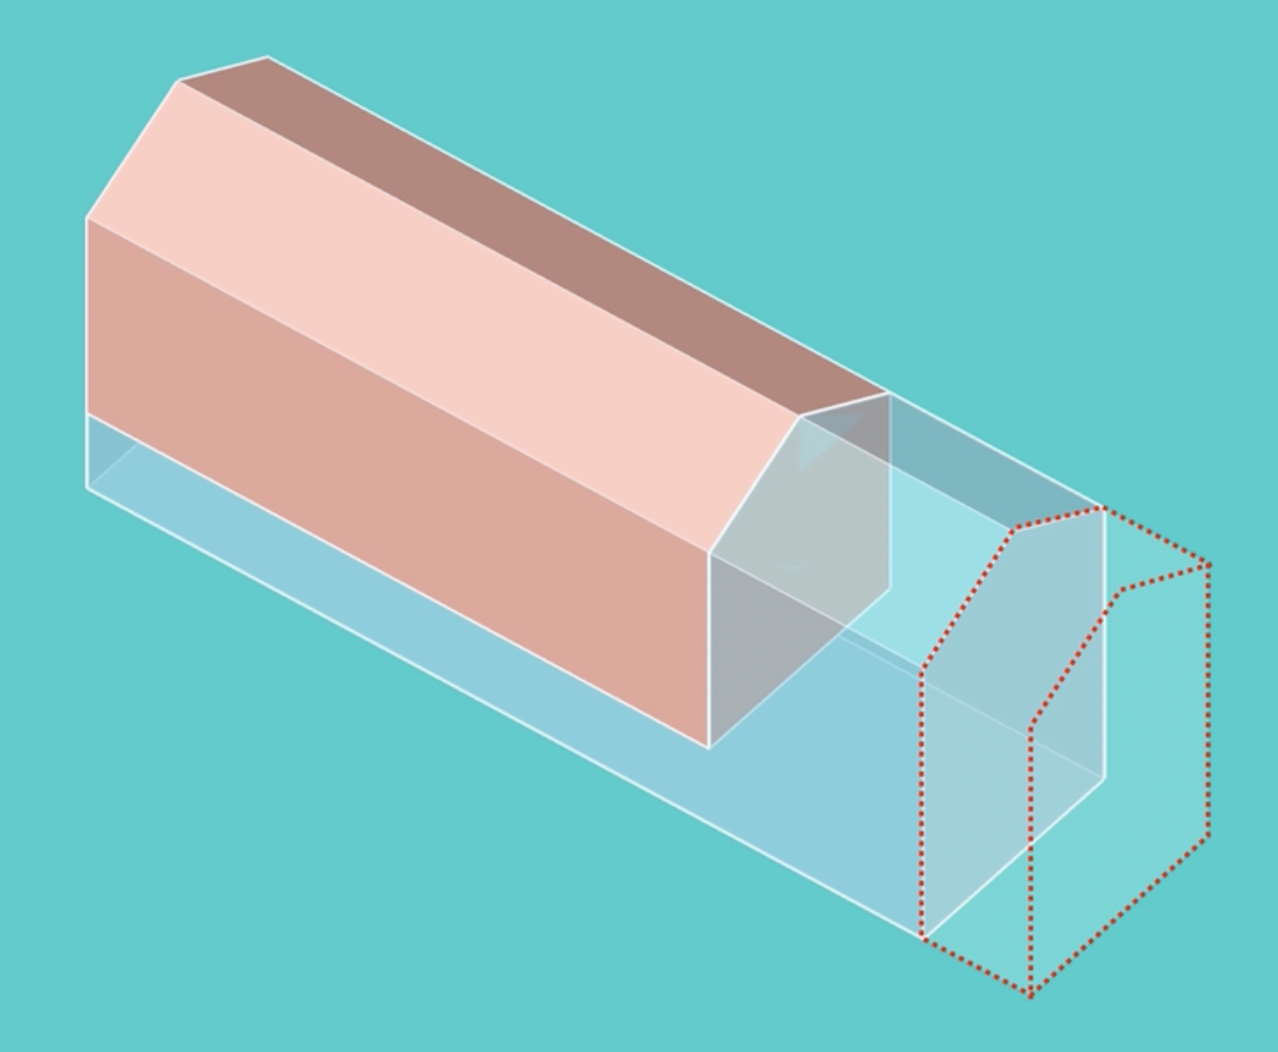

Slide 19
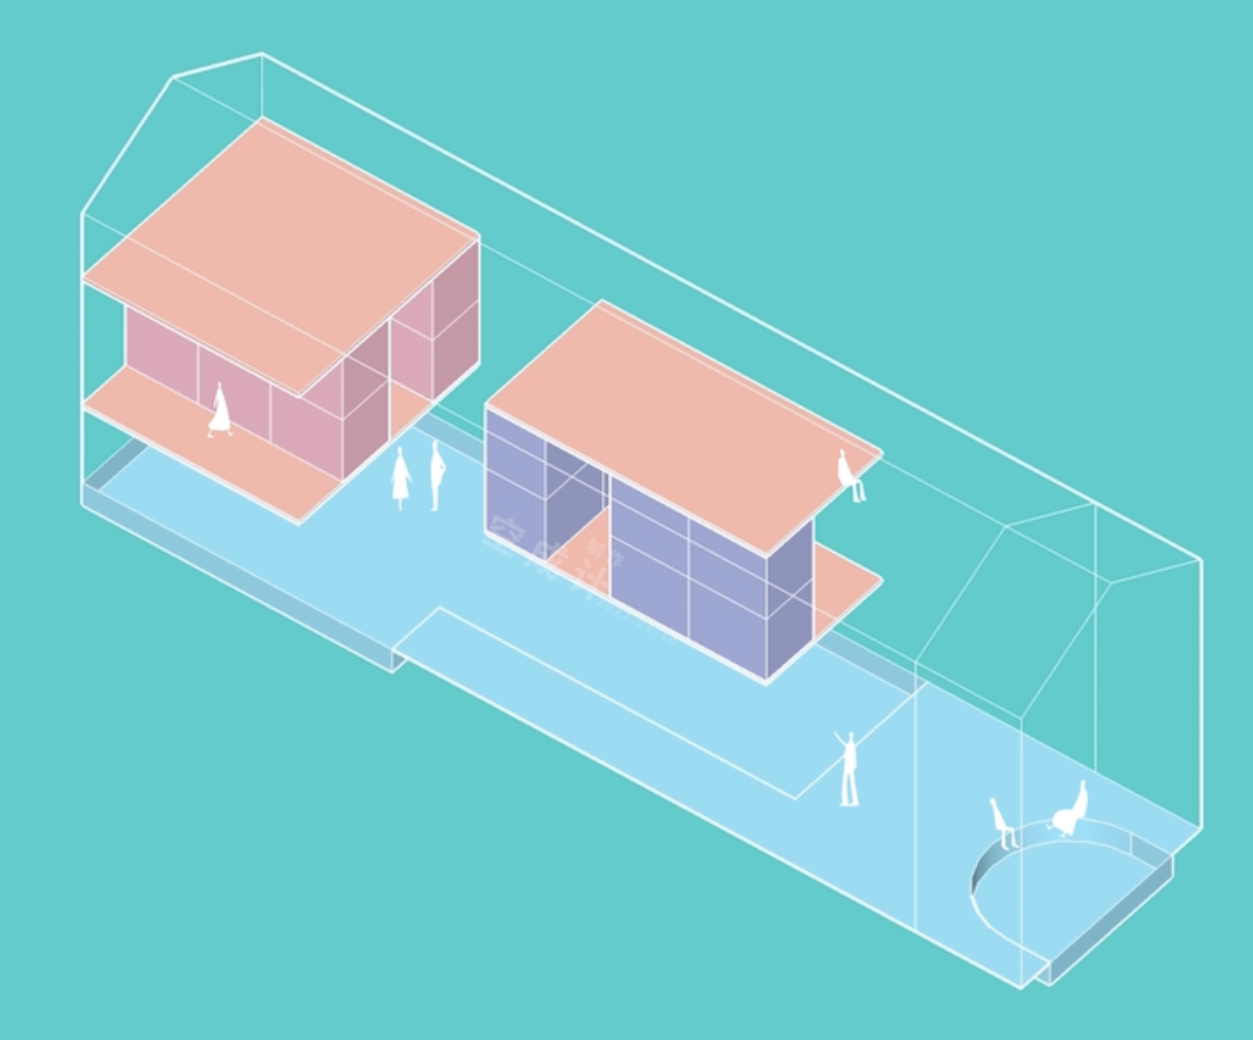

Slide 20
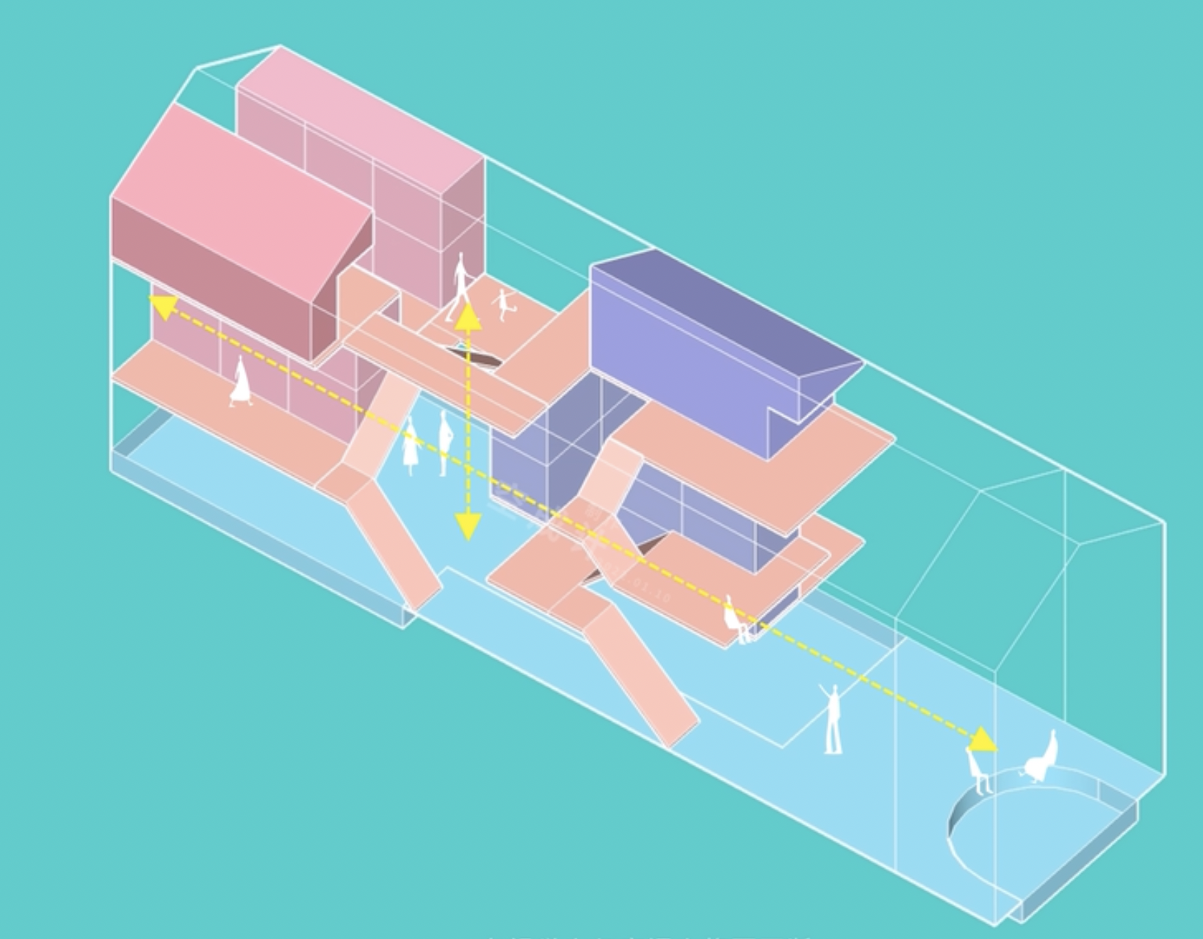

Slide 21
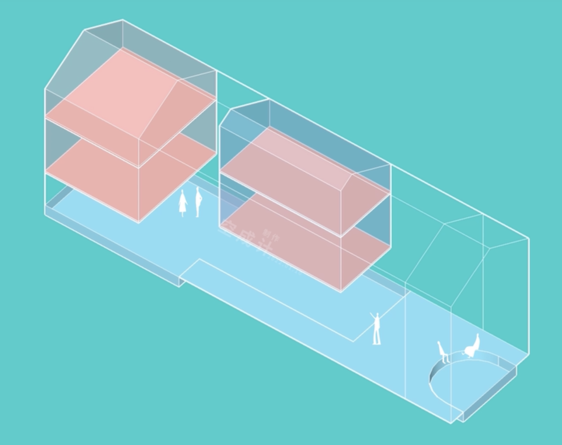

Slide 22
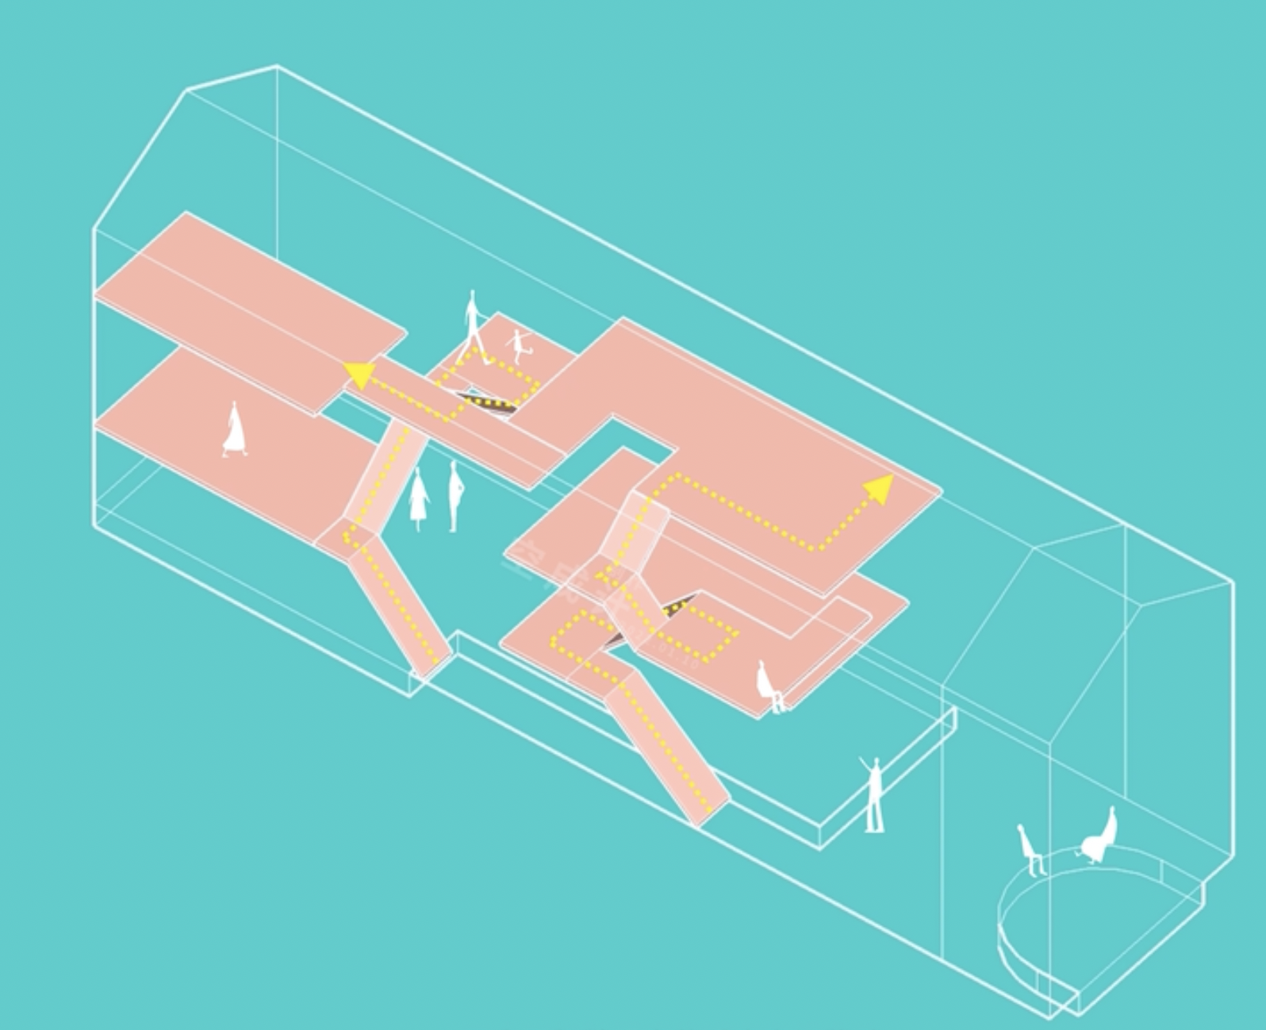

Slide 23
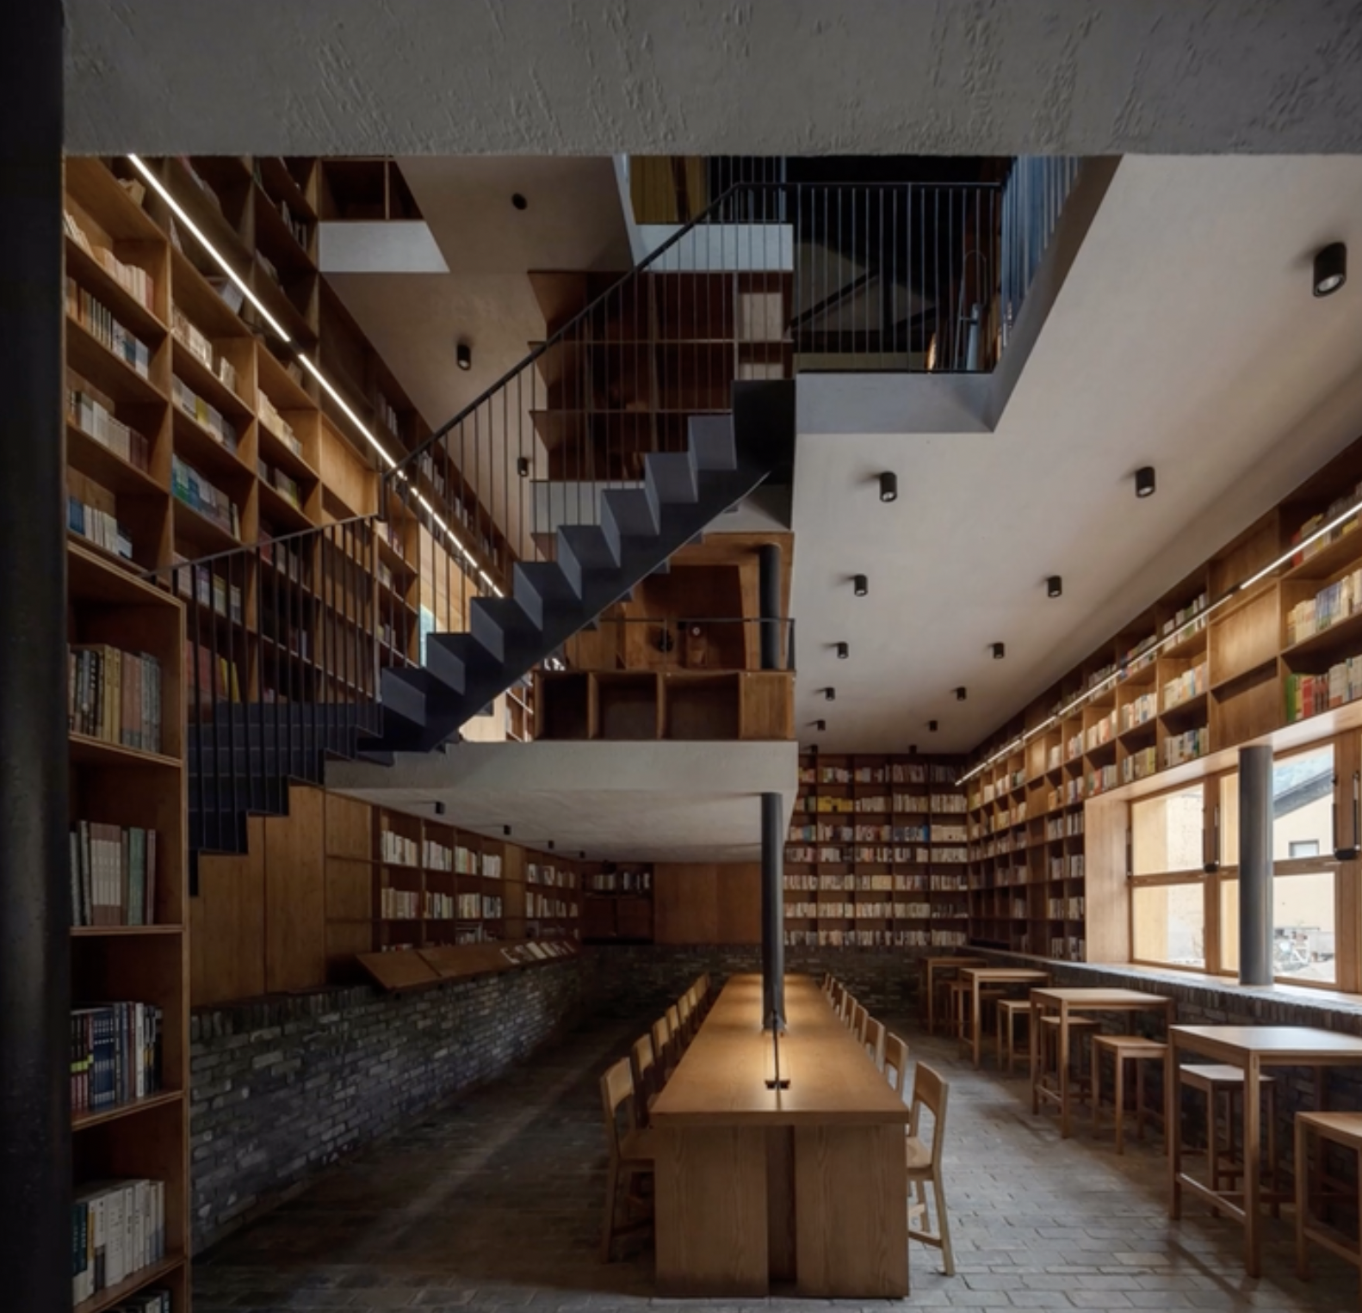

Slide 24
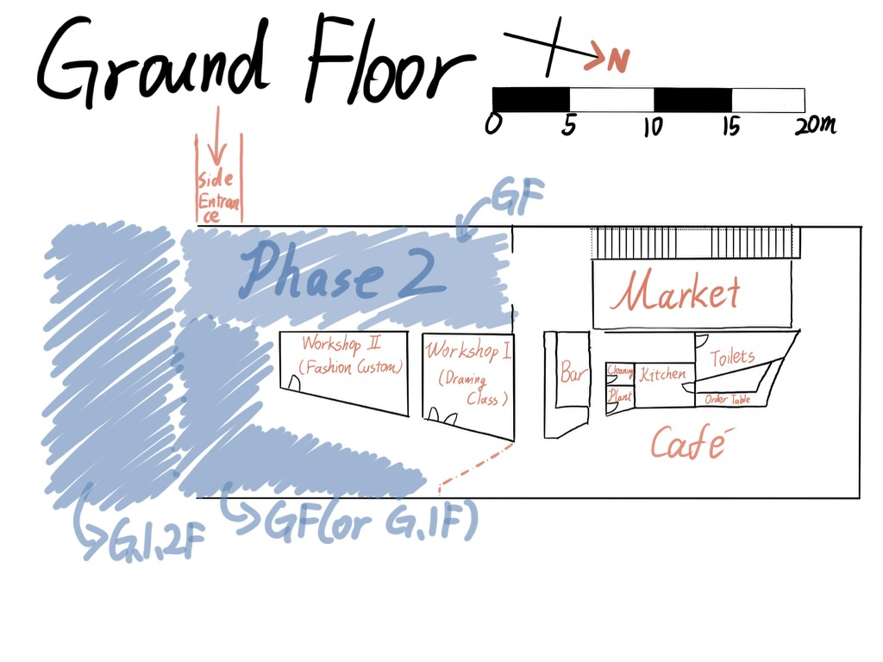


Slide 25

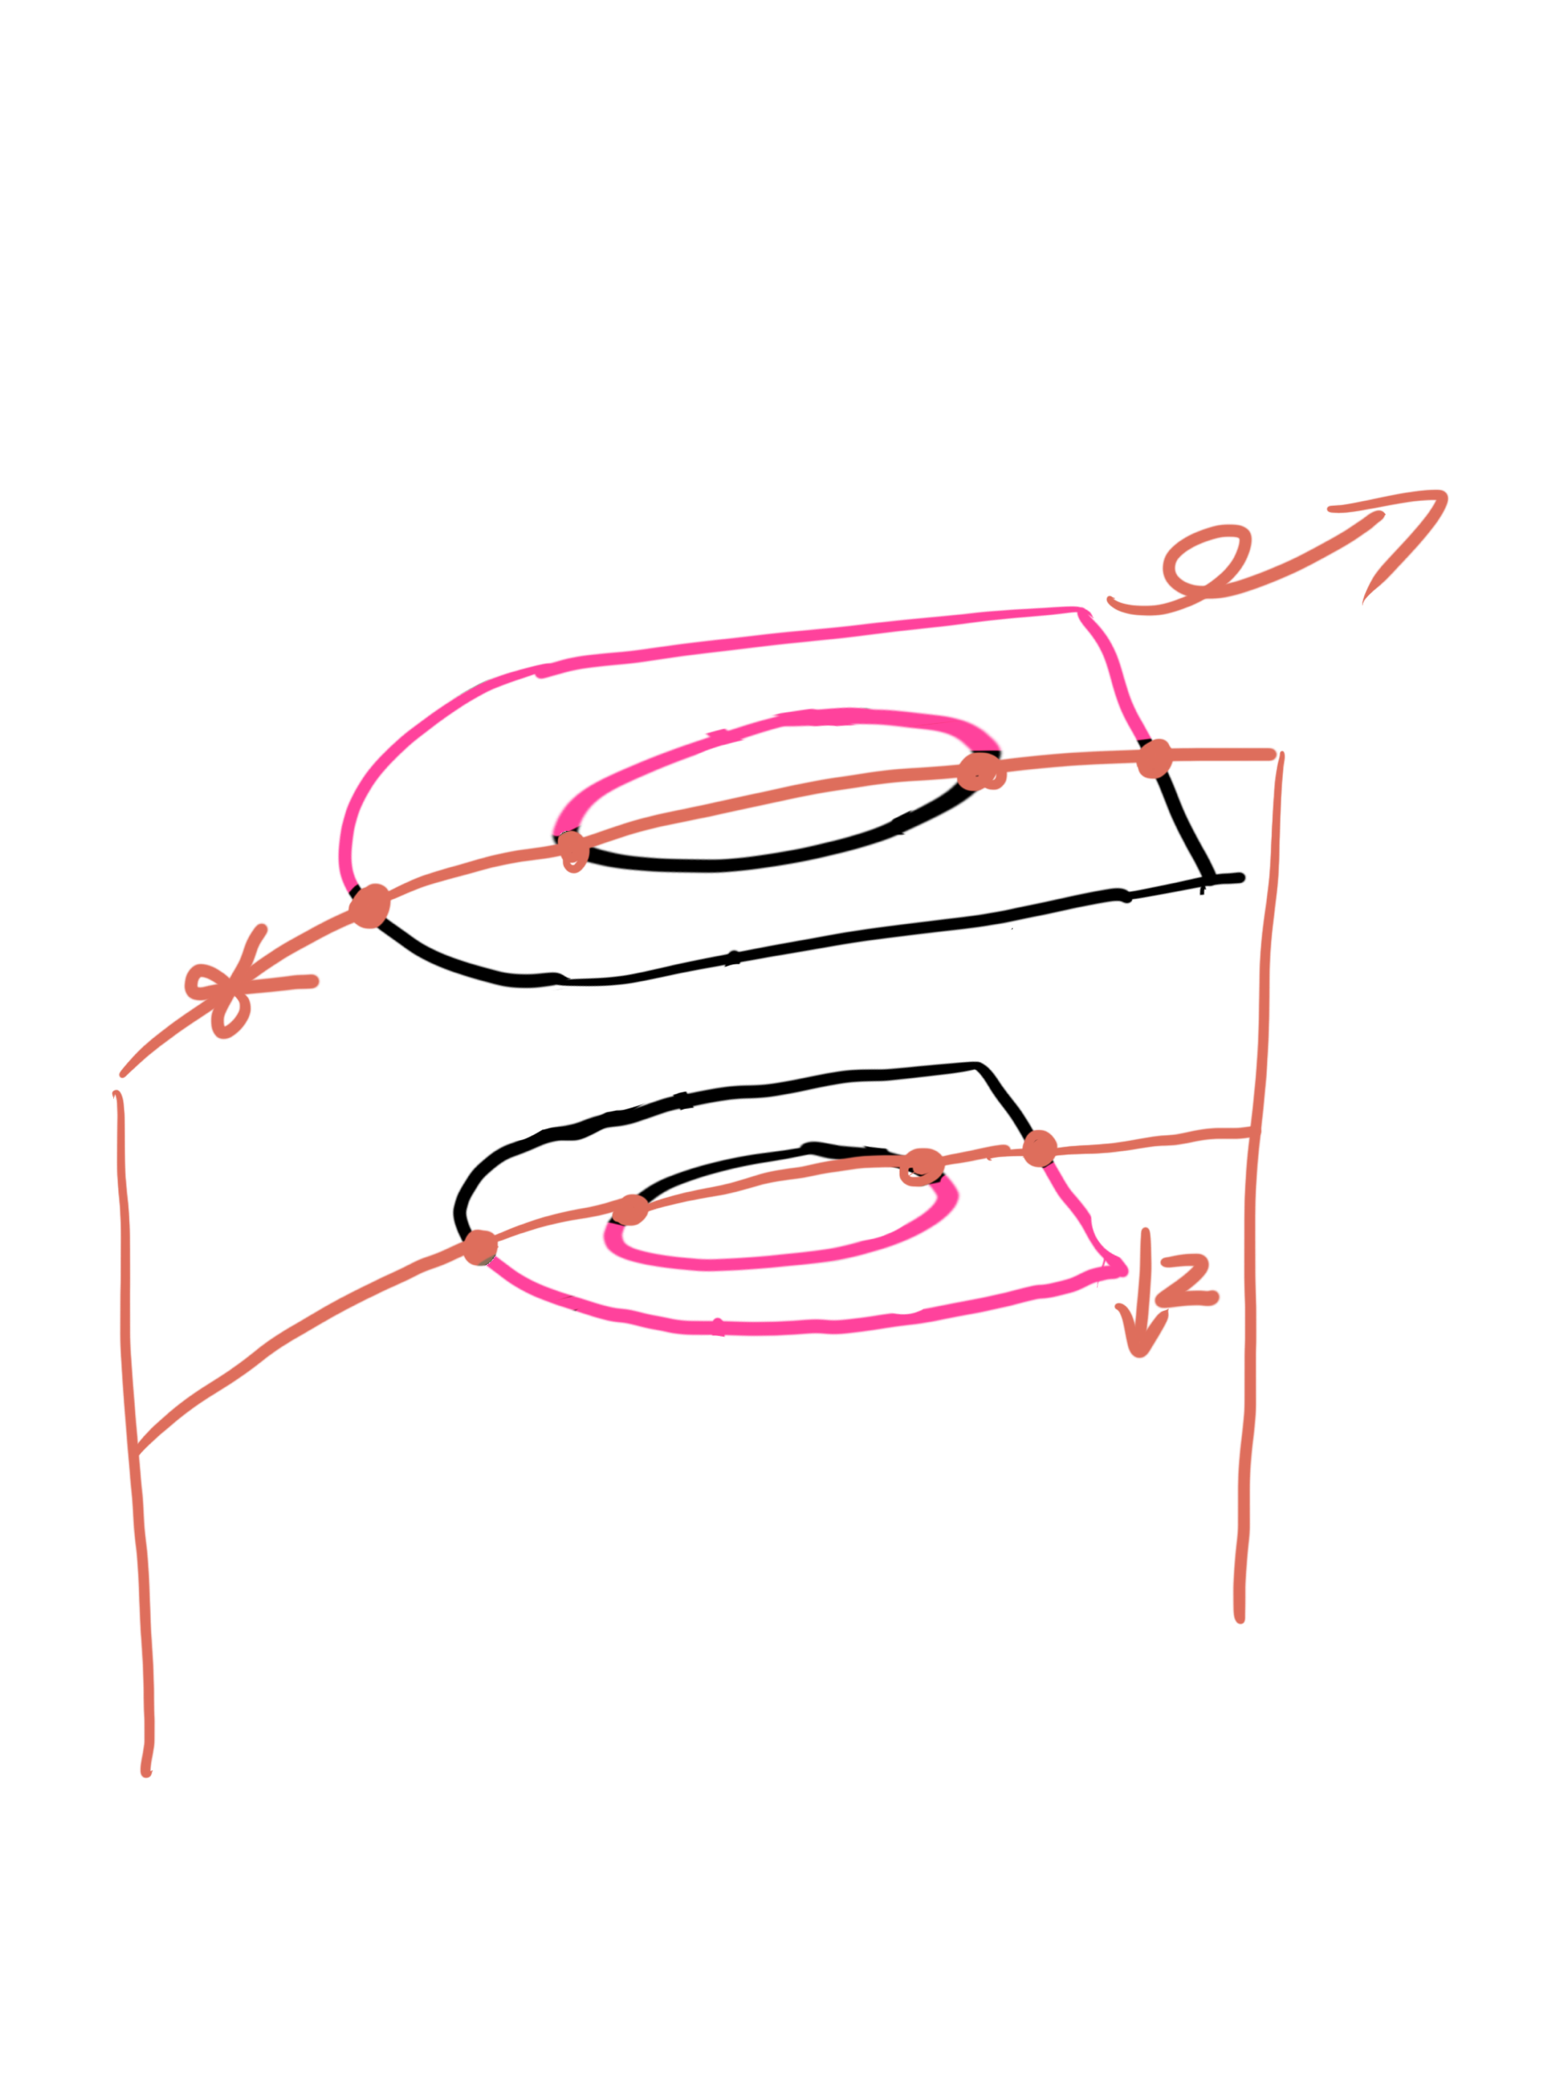
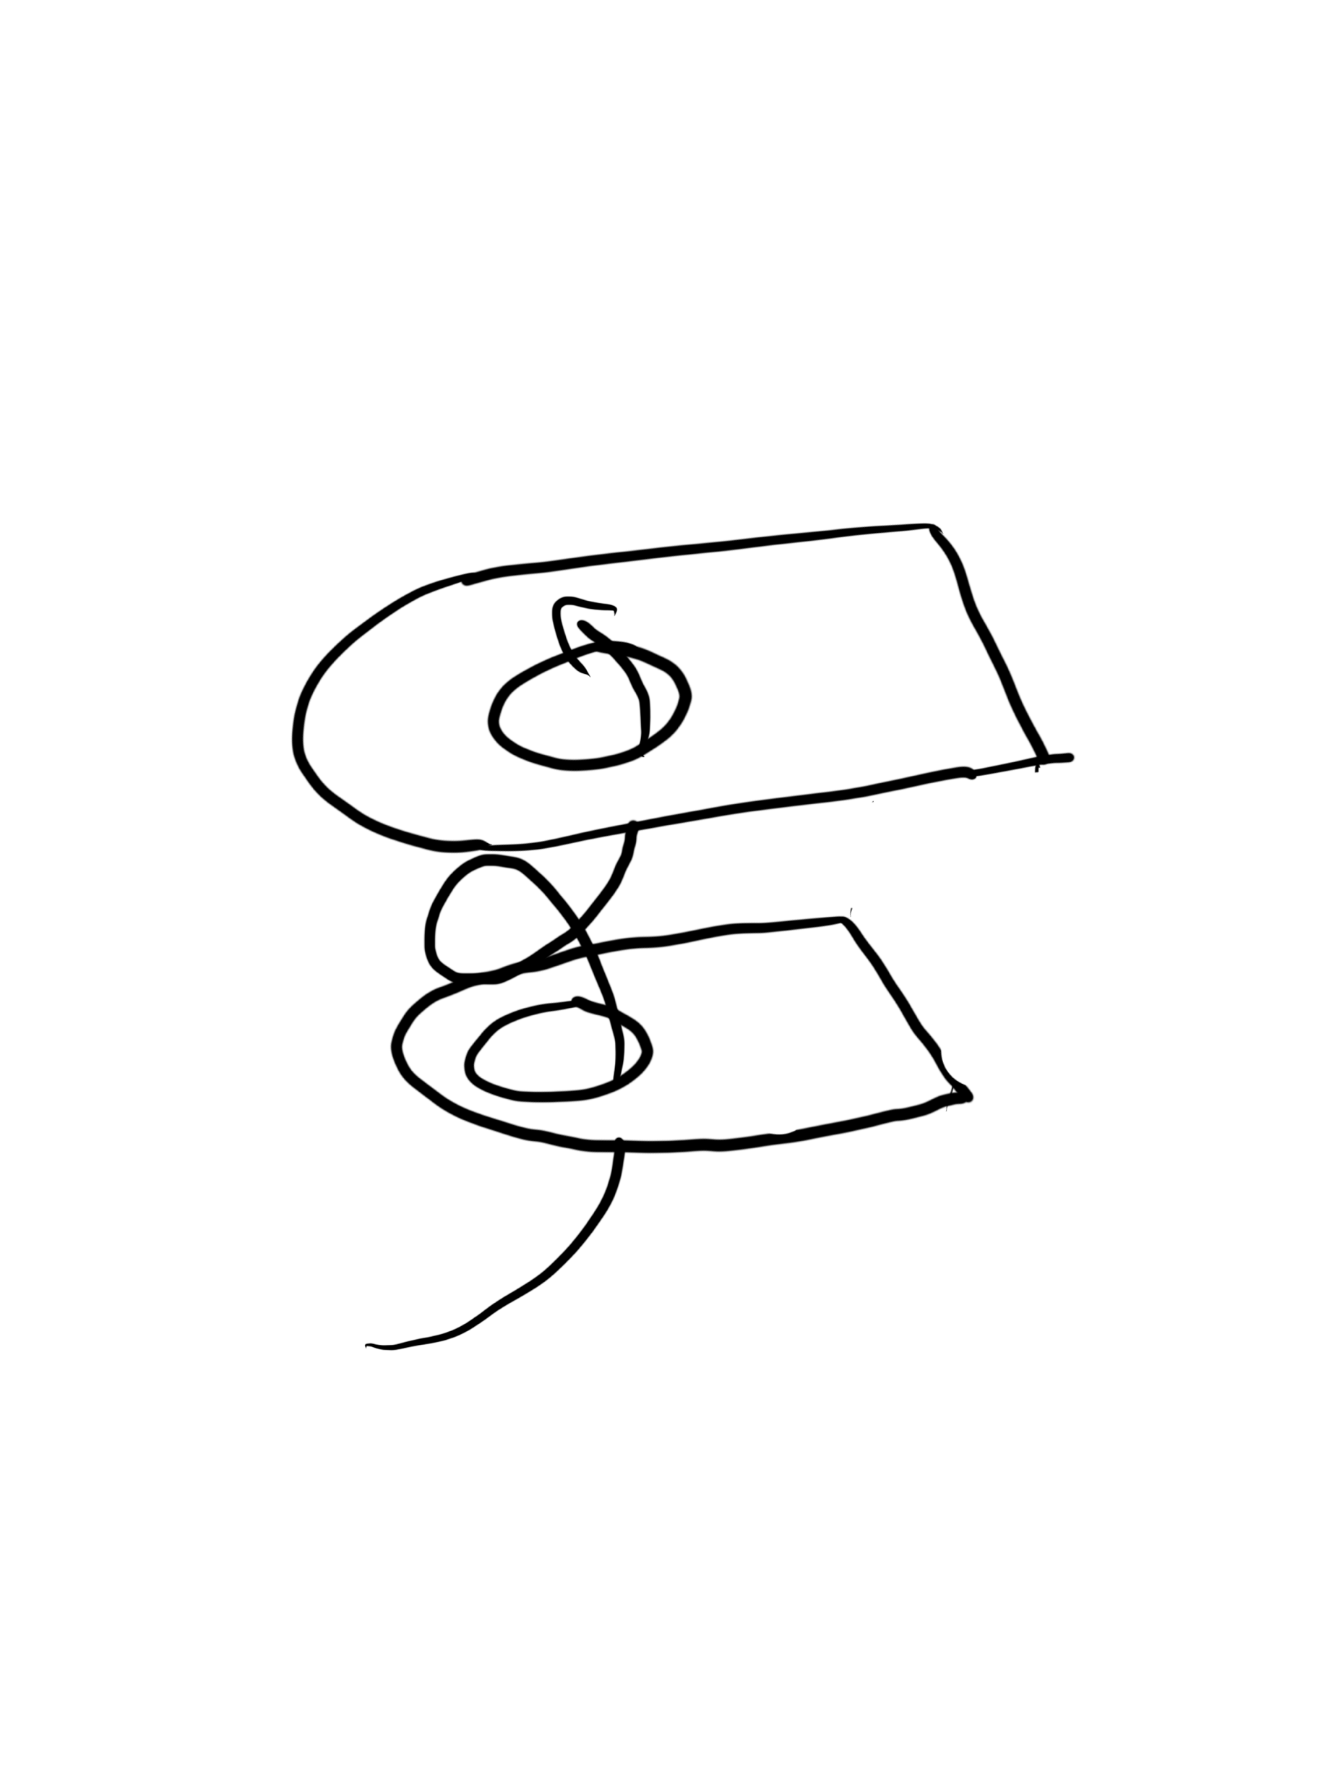
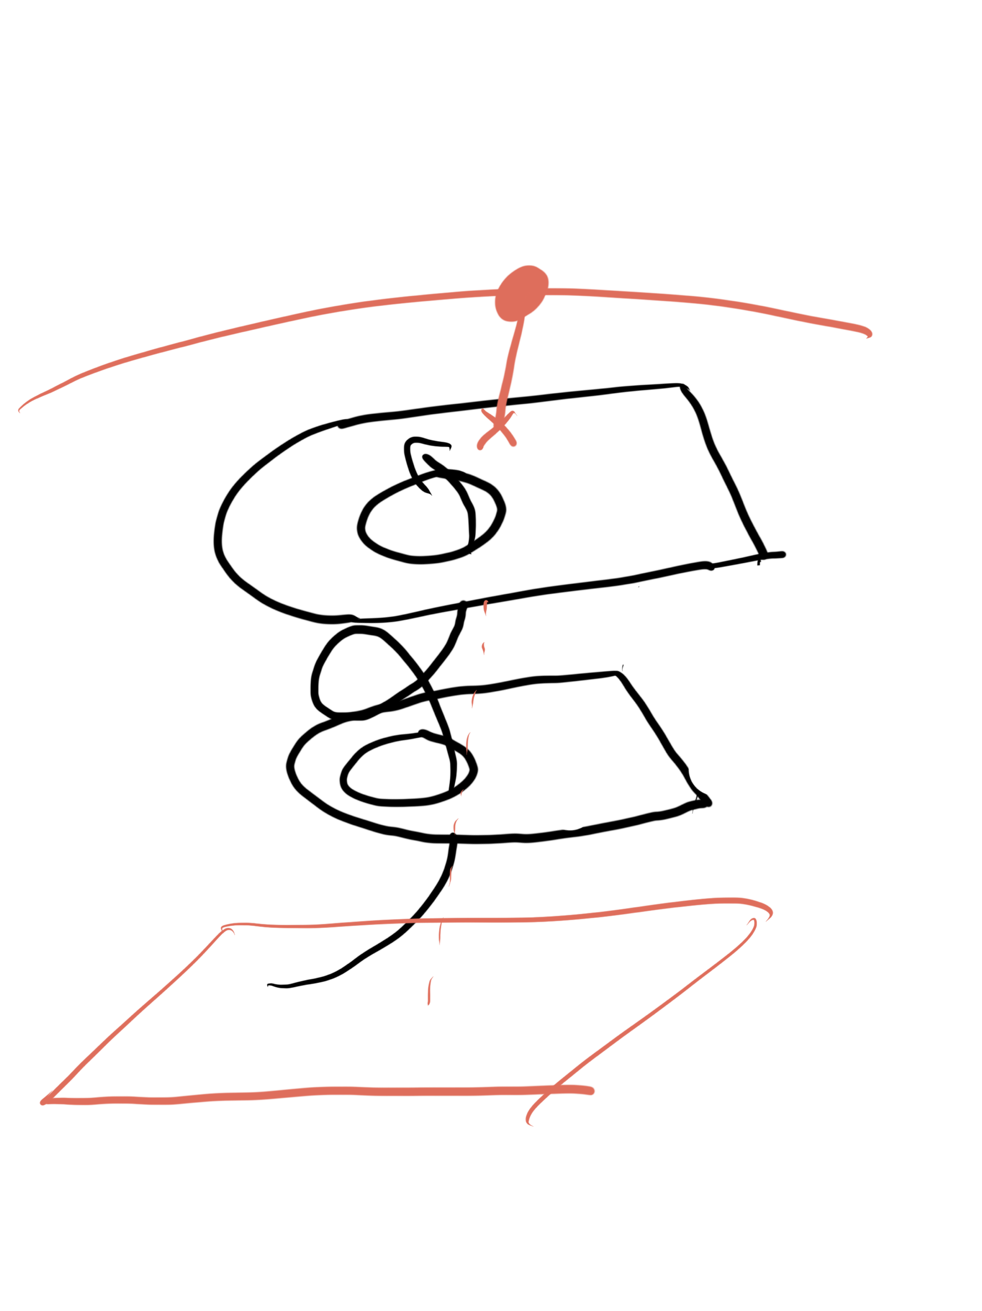
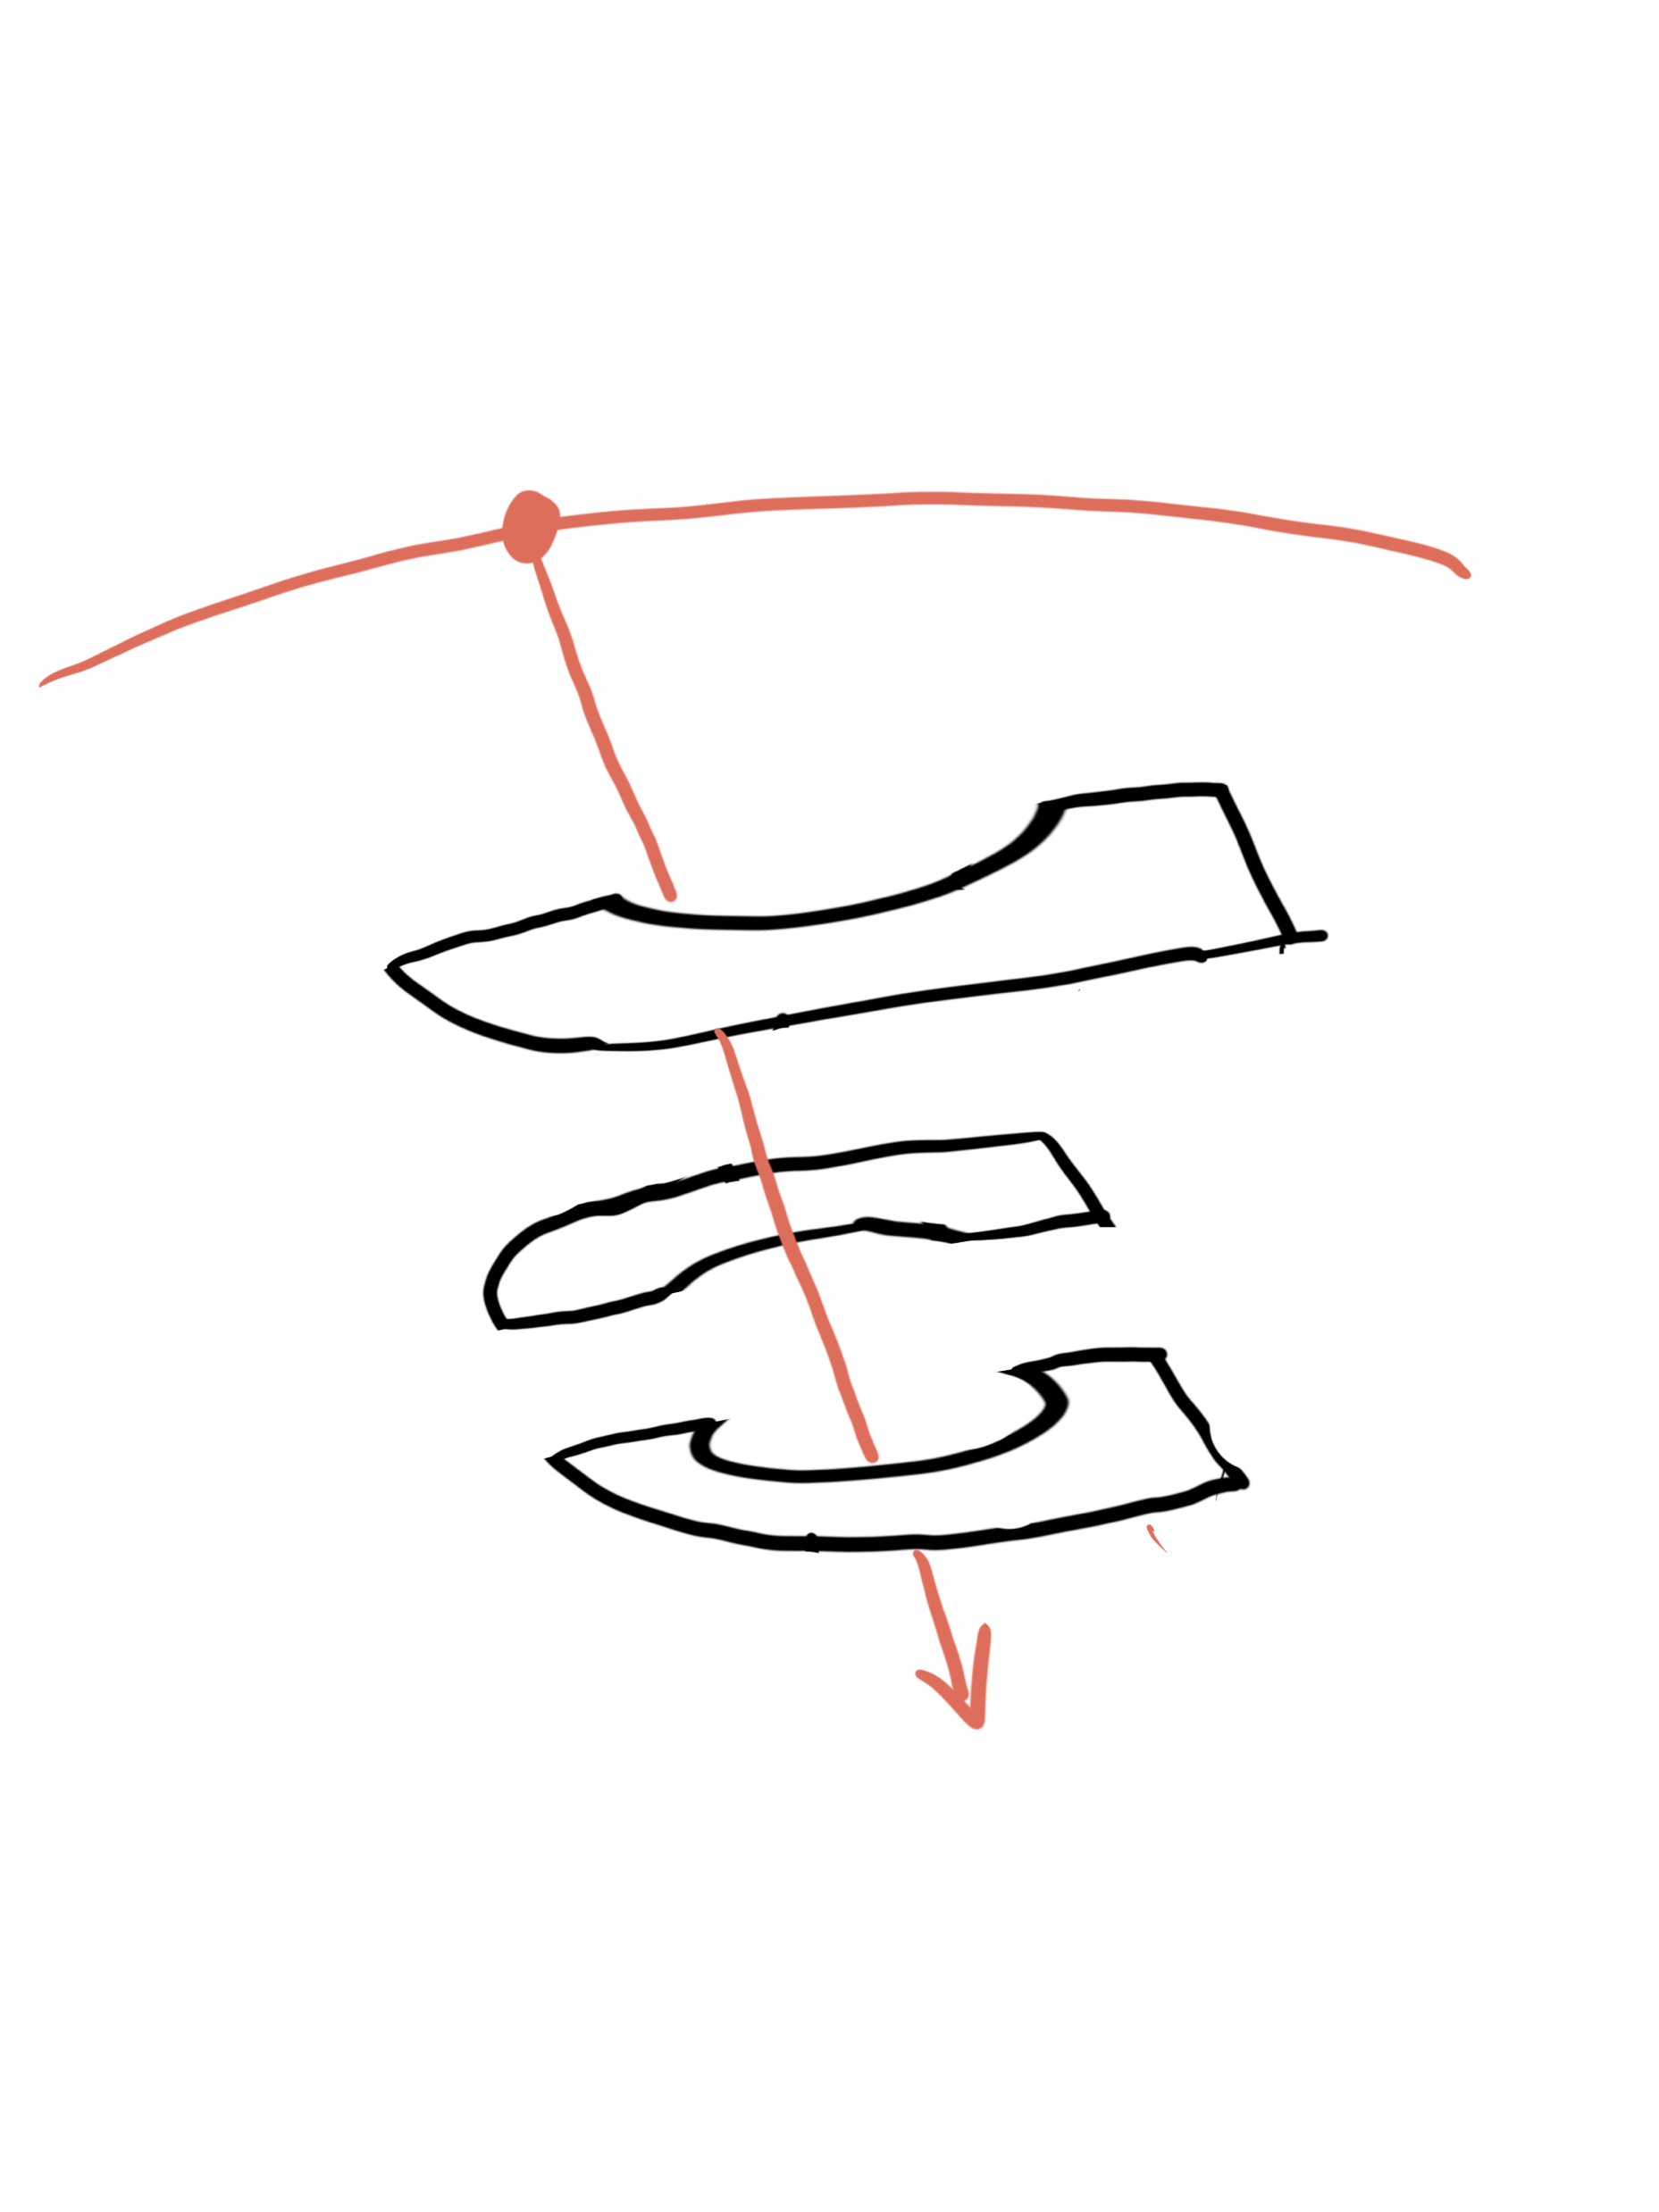


Slide 26
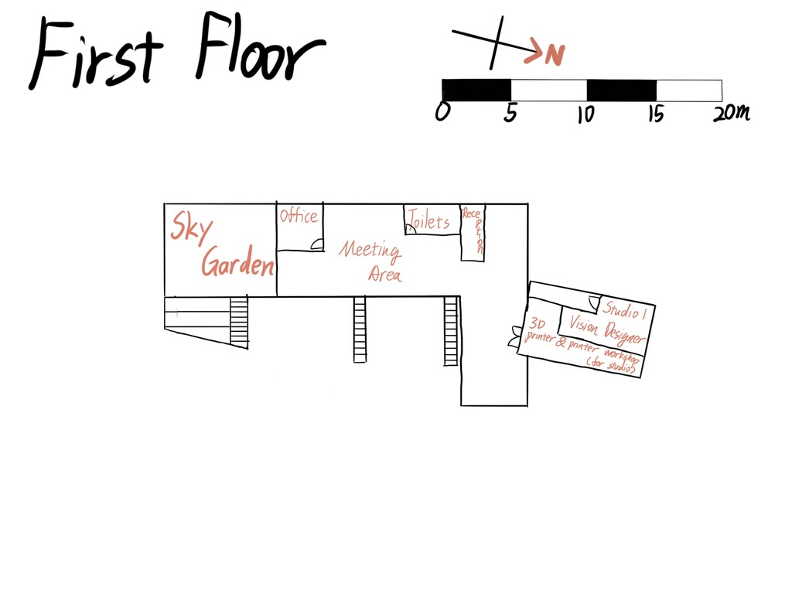

Slide 27
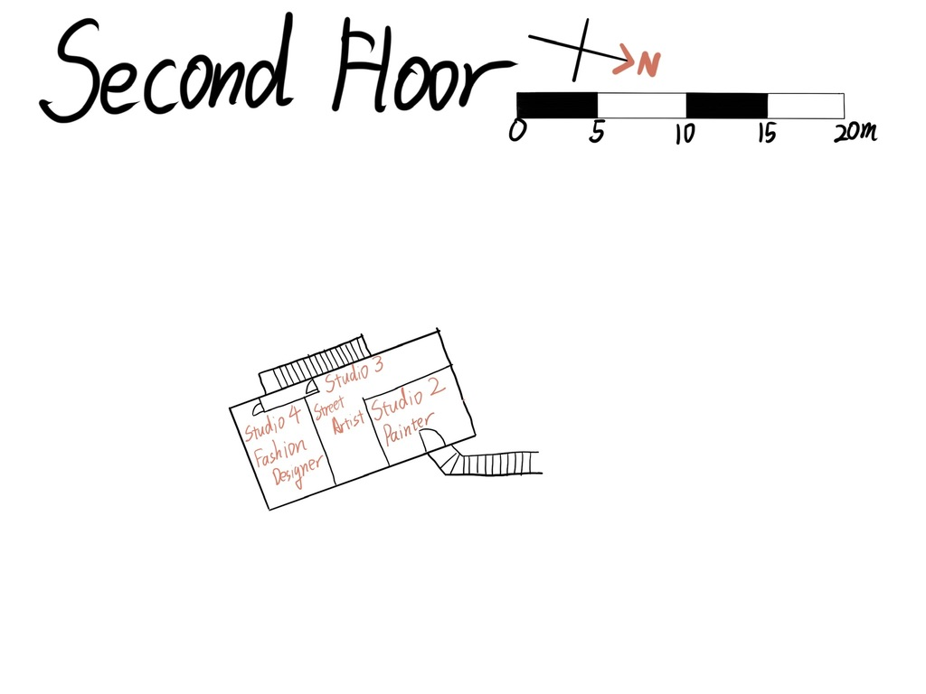

Slide 28
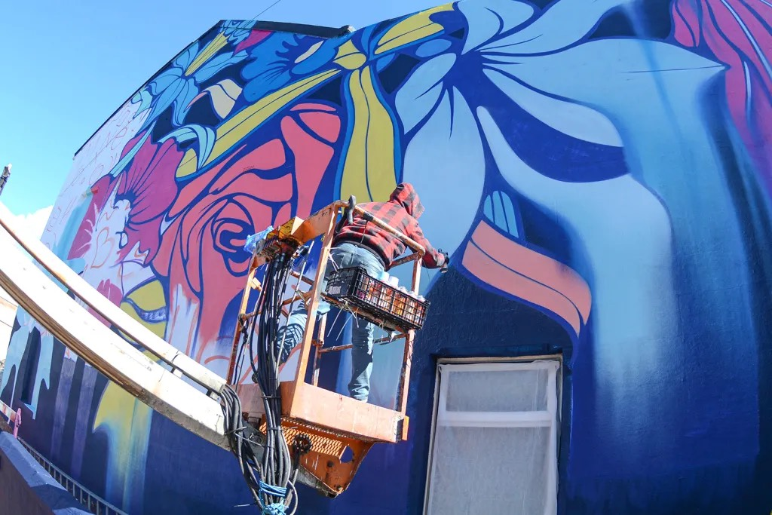

Slide 29
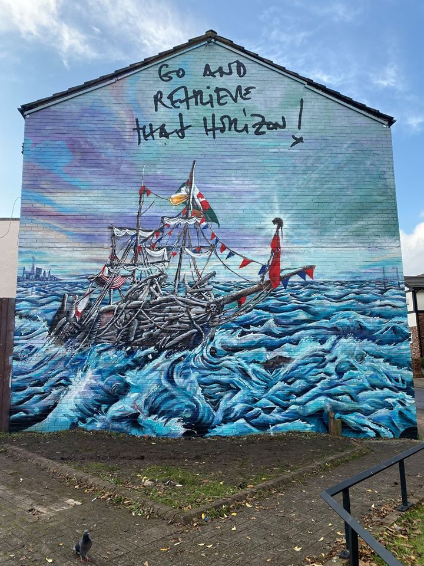

Slide 30
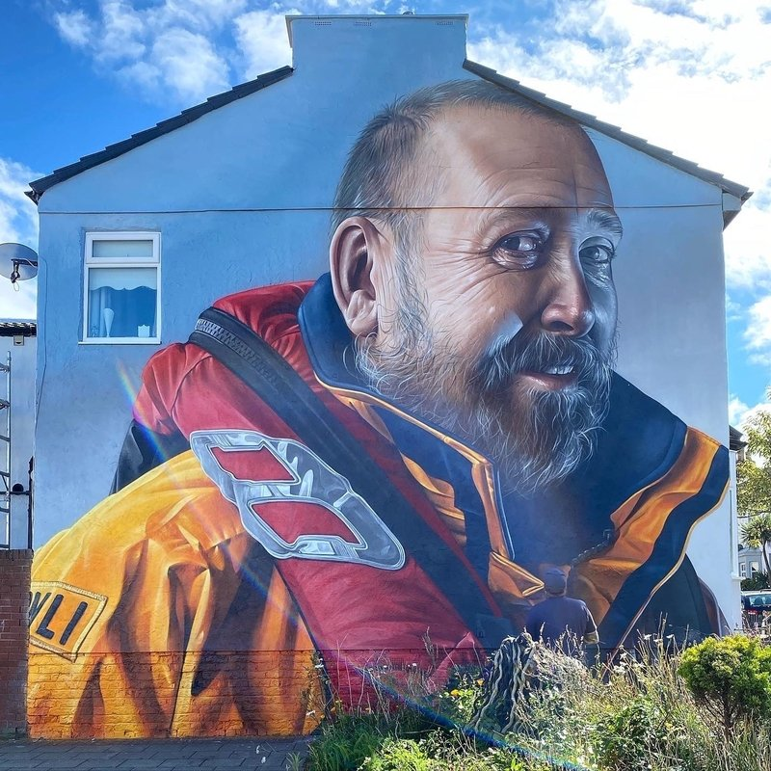

Slide 32
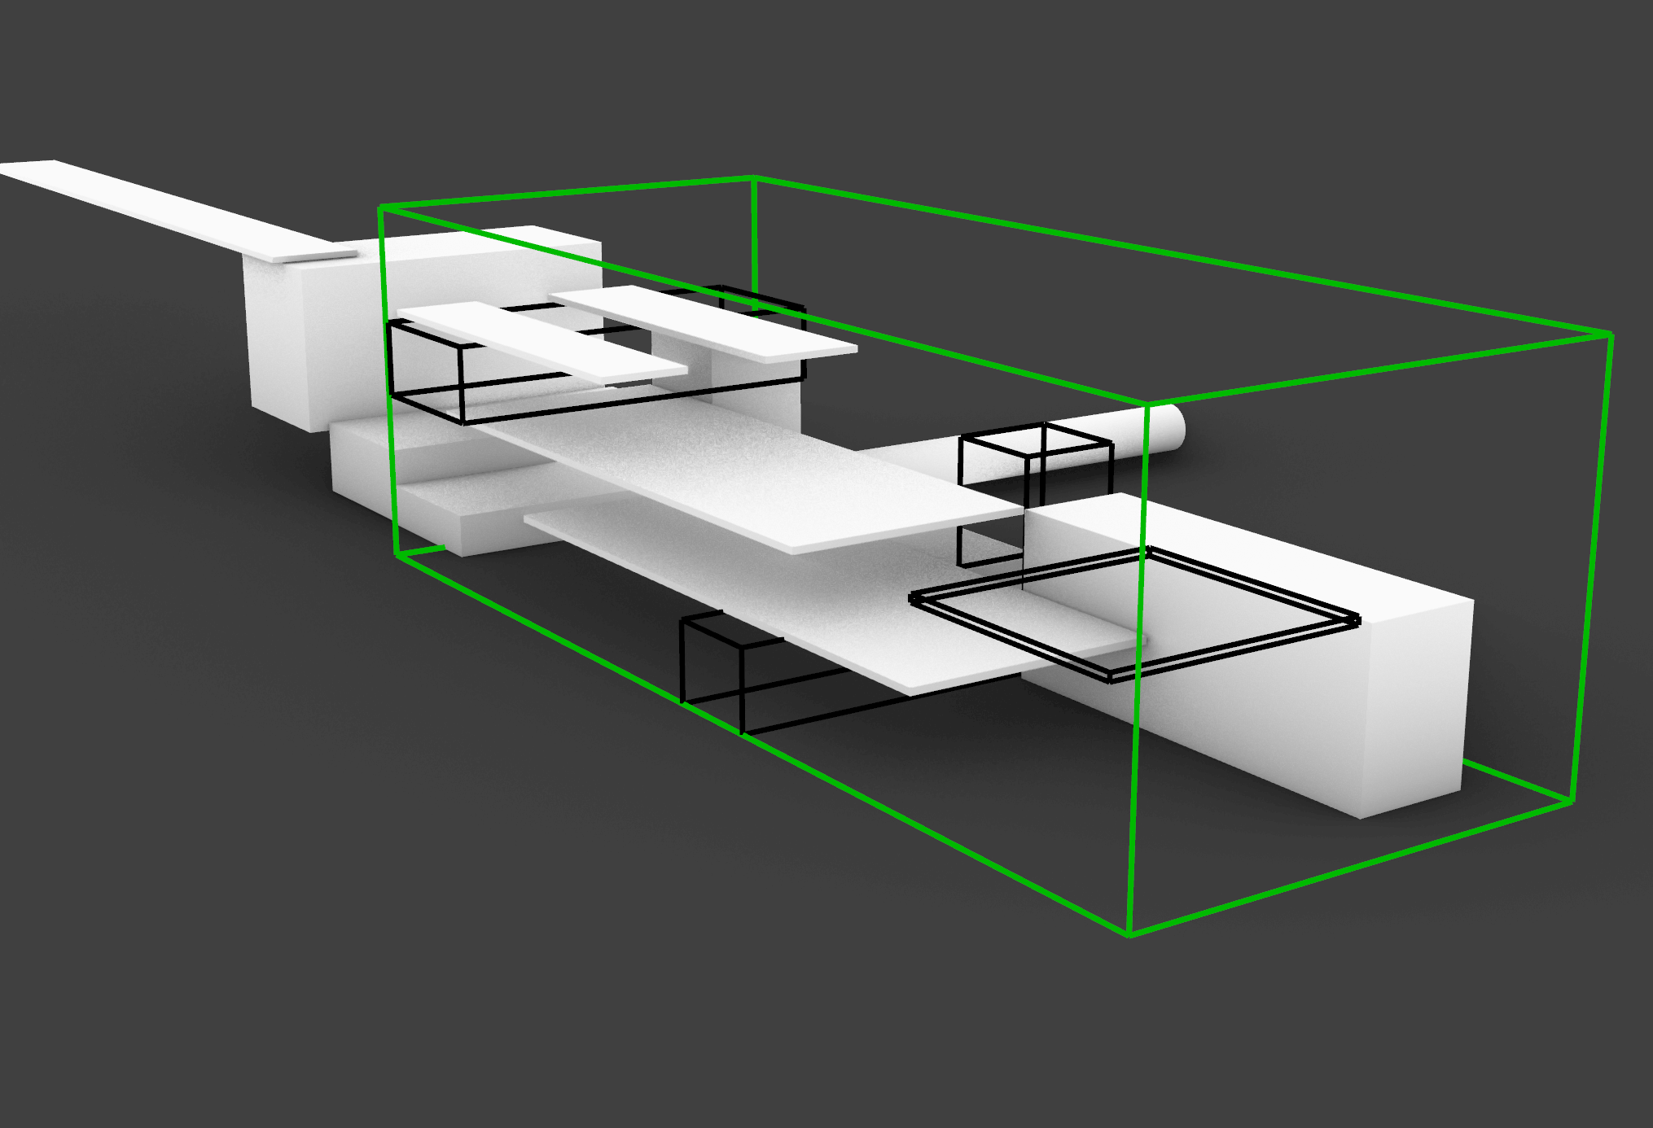

Slide 33
